Slide 1
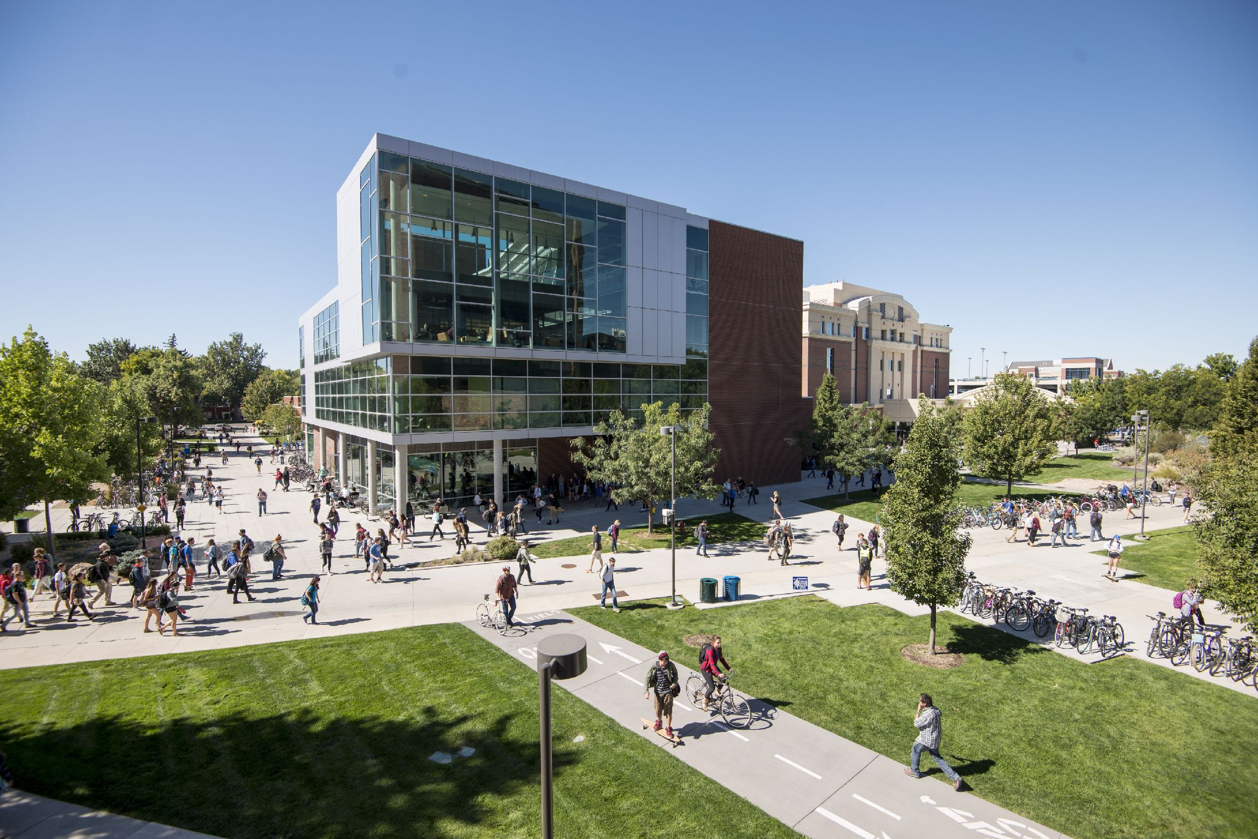

Reproducible Prediction Of Organic Semiconductor Properties Through Open-Source Software Development
June 9, 2022
Jimmy Rushing
Notes:
Thank you Dr. Jankowski and thanks you everyone for coming. Today I am going to talk about some work that we have been doing on our software for simulating organic semiconductors.
The unique properties of organic semiconductors make them ideal candidates for many electronic applications. They are used today in ultra high resolution Organic Light Emitting Diode (OLED) TVs and cellphone displays. They enable foldable OLED screens and rollable TVs [? ]. Organic semiconductors are also integral to the design of next generation medical devices owing to their self-healing properties and their biodegradability [? ].
Throughout this presentation I am going focus on a subclass of organic semiconductors, Organic Photovoltaic (OPV) materials, and their use in the active layer of Organic Solar Cell (OSC) devices. OSCs can provide flexibility, processability beyond that of traditional silicon based solar cells.
They are also used in more revolutionary electronic designs. For example, researchers have exploited the relatively narrow absorption spectrum in OPVs (∼300nm) to make windows that act as OSCs. They achieved this by tuning the active layer material to absorb radiation right above or right below the visible spectrum (into the NIR or UV spectrum respectively). Semi-transparent OSCs have already reached 11 % efficiency [5] .
The processability of these materials stems from the fact that they can be deposited from solution and ink printed or roll-to-roll manufavtured. Therefore, engineering the self-assembly and resulting conductivity is critical for advancing the performance of these materials. I we think its prudent to be able to do so with computers.

Slide 2
Talk Outline
Organic Solar cells and Organic photovoltaics background
Methods of simulating self-assembly and charge transport
Software development for simulating charge transport
Notes:
OUTLINE OF TALK:
For this presentation, I am going give a brief background on OSCs and introduce the specific OPVs that I am going to discuss today.
I am then going to introduce our methods involved in simulating the self assembly and charge transport of opvs as well as the software packages that we develop for the execution of these methods.
Finally, I am going to talk about some of the specifics of the development that I have done on our software package for simulating charge transport.
So what is an organic solar cell and at what level are we simulating it?

Slide 3
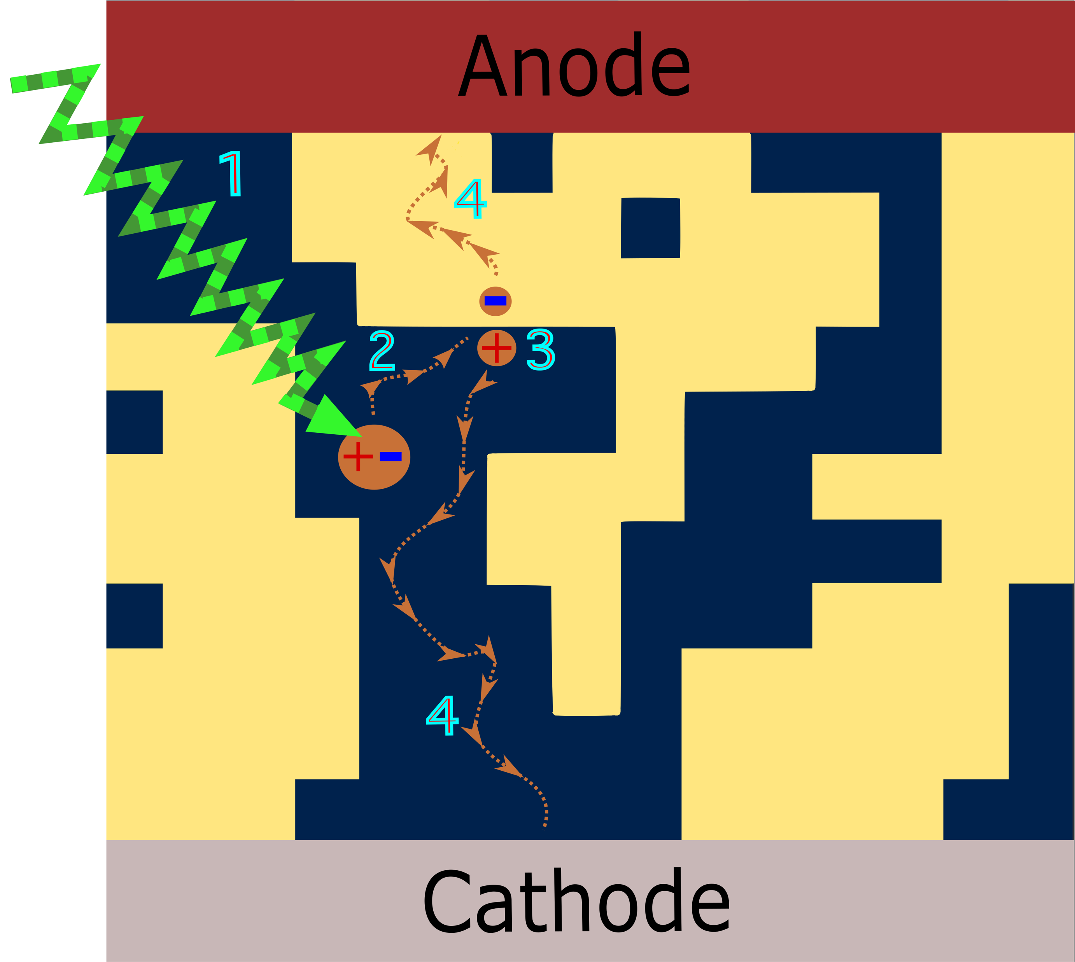
Bulk-heterojunction Device
Notes:
A simple model for an OSCs is that they are OLEDs working in reverse, absorbing photons and generating current rather than converting current into light.
HERE WE SEE A
ACCEPTOR YELLOW DONOR BLUE
A LOW PERMITTIVY IN THESE MATERIALS MEANS A Relatively HIGH COULOMB FORCE BETWEEN ELECTRON AND HOLE
We are going talk about how we can simulate stage 4. That is electron diffusion in acceptor material and holes diffusion in donor material.
A little bit more about the specific donor and acceptor material that we are going to discuss.

Slide 4
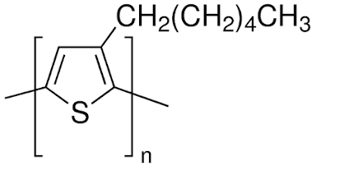
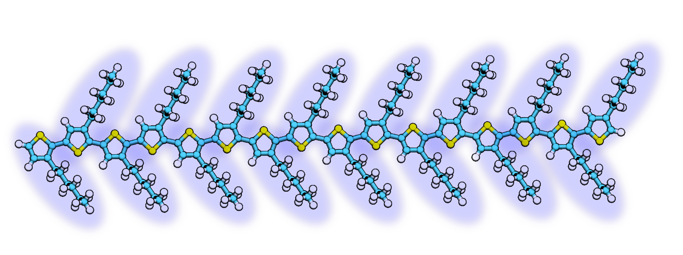
Polymeric Donors
P3HT
Poly-(3-hexylthiophene) (P3HT)
Notes:
P3HT is used a hole transporter and is termed a donor. Donors are are analgous to p-type inorganic semi conductors.
P3HT is a polymeric material that can self-assemble into a wide spectrum of crystallinities depending on how it is processed. IT became a commonly used donor when it was synthesized to have this head-to-tail arrangement that can result in the side chains interlocking and forming lamellar microstructures that can act as highways of charge transport.
The acceptor that we are going to simulate if ITIC.

Slide 5
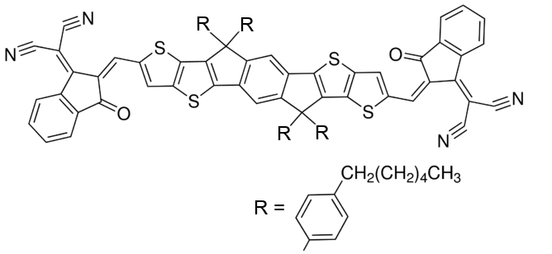
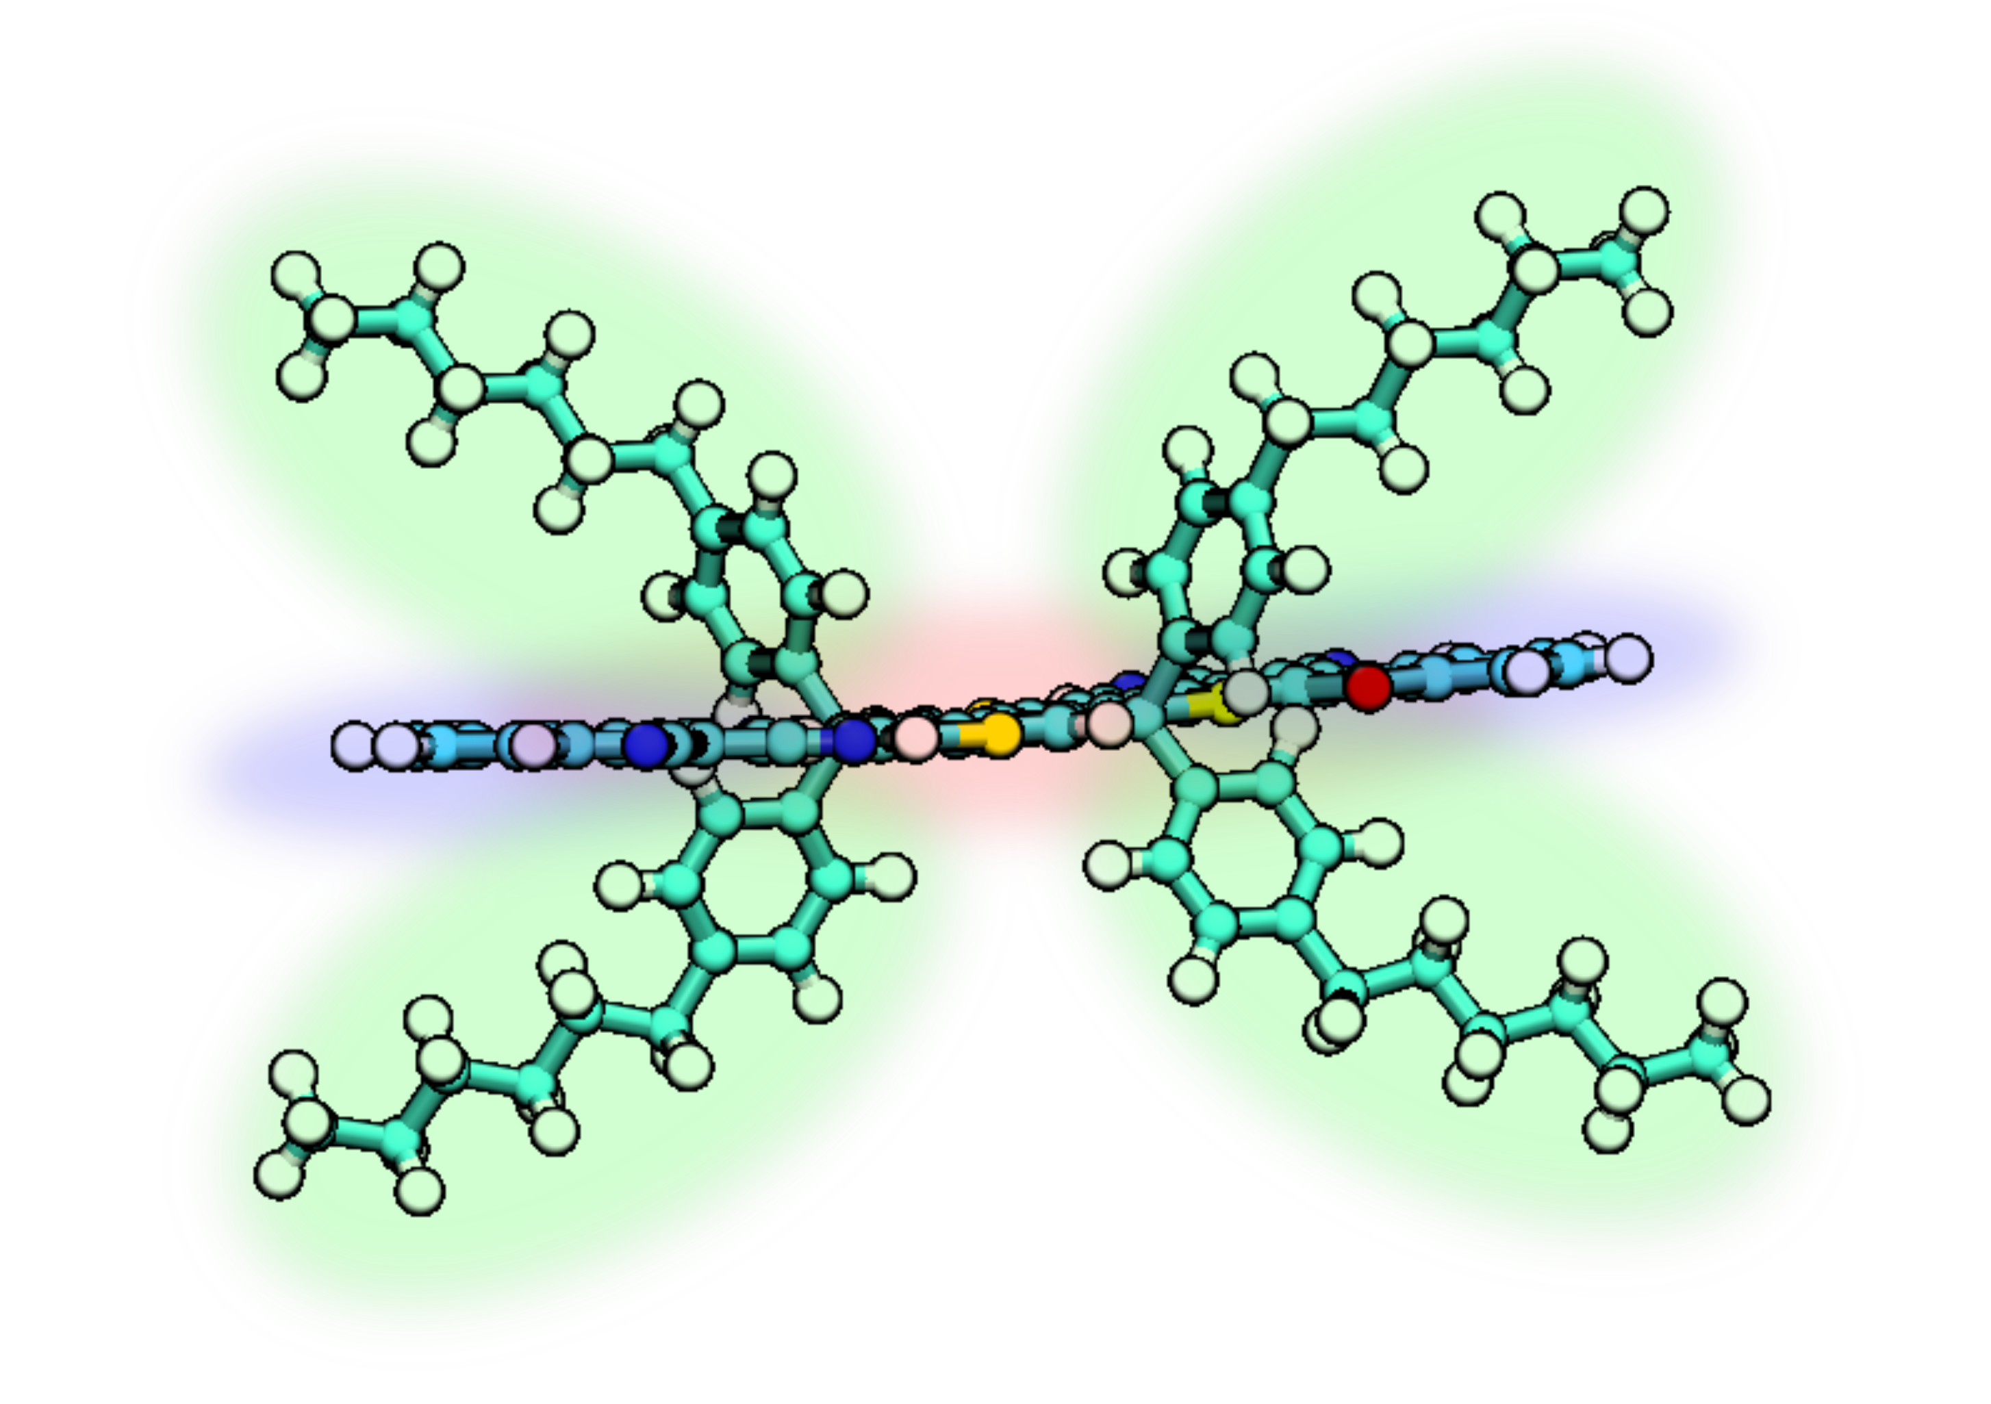
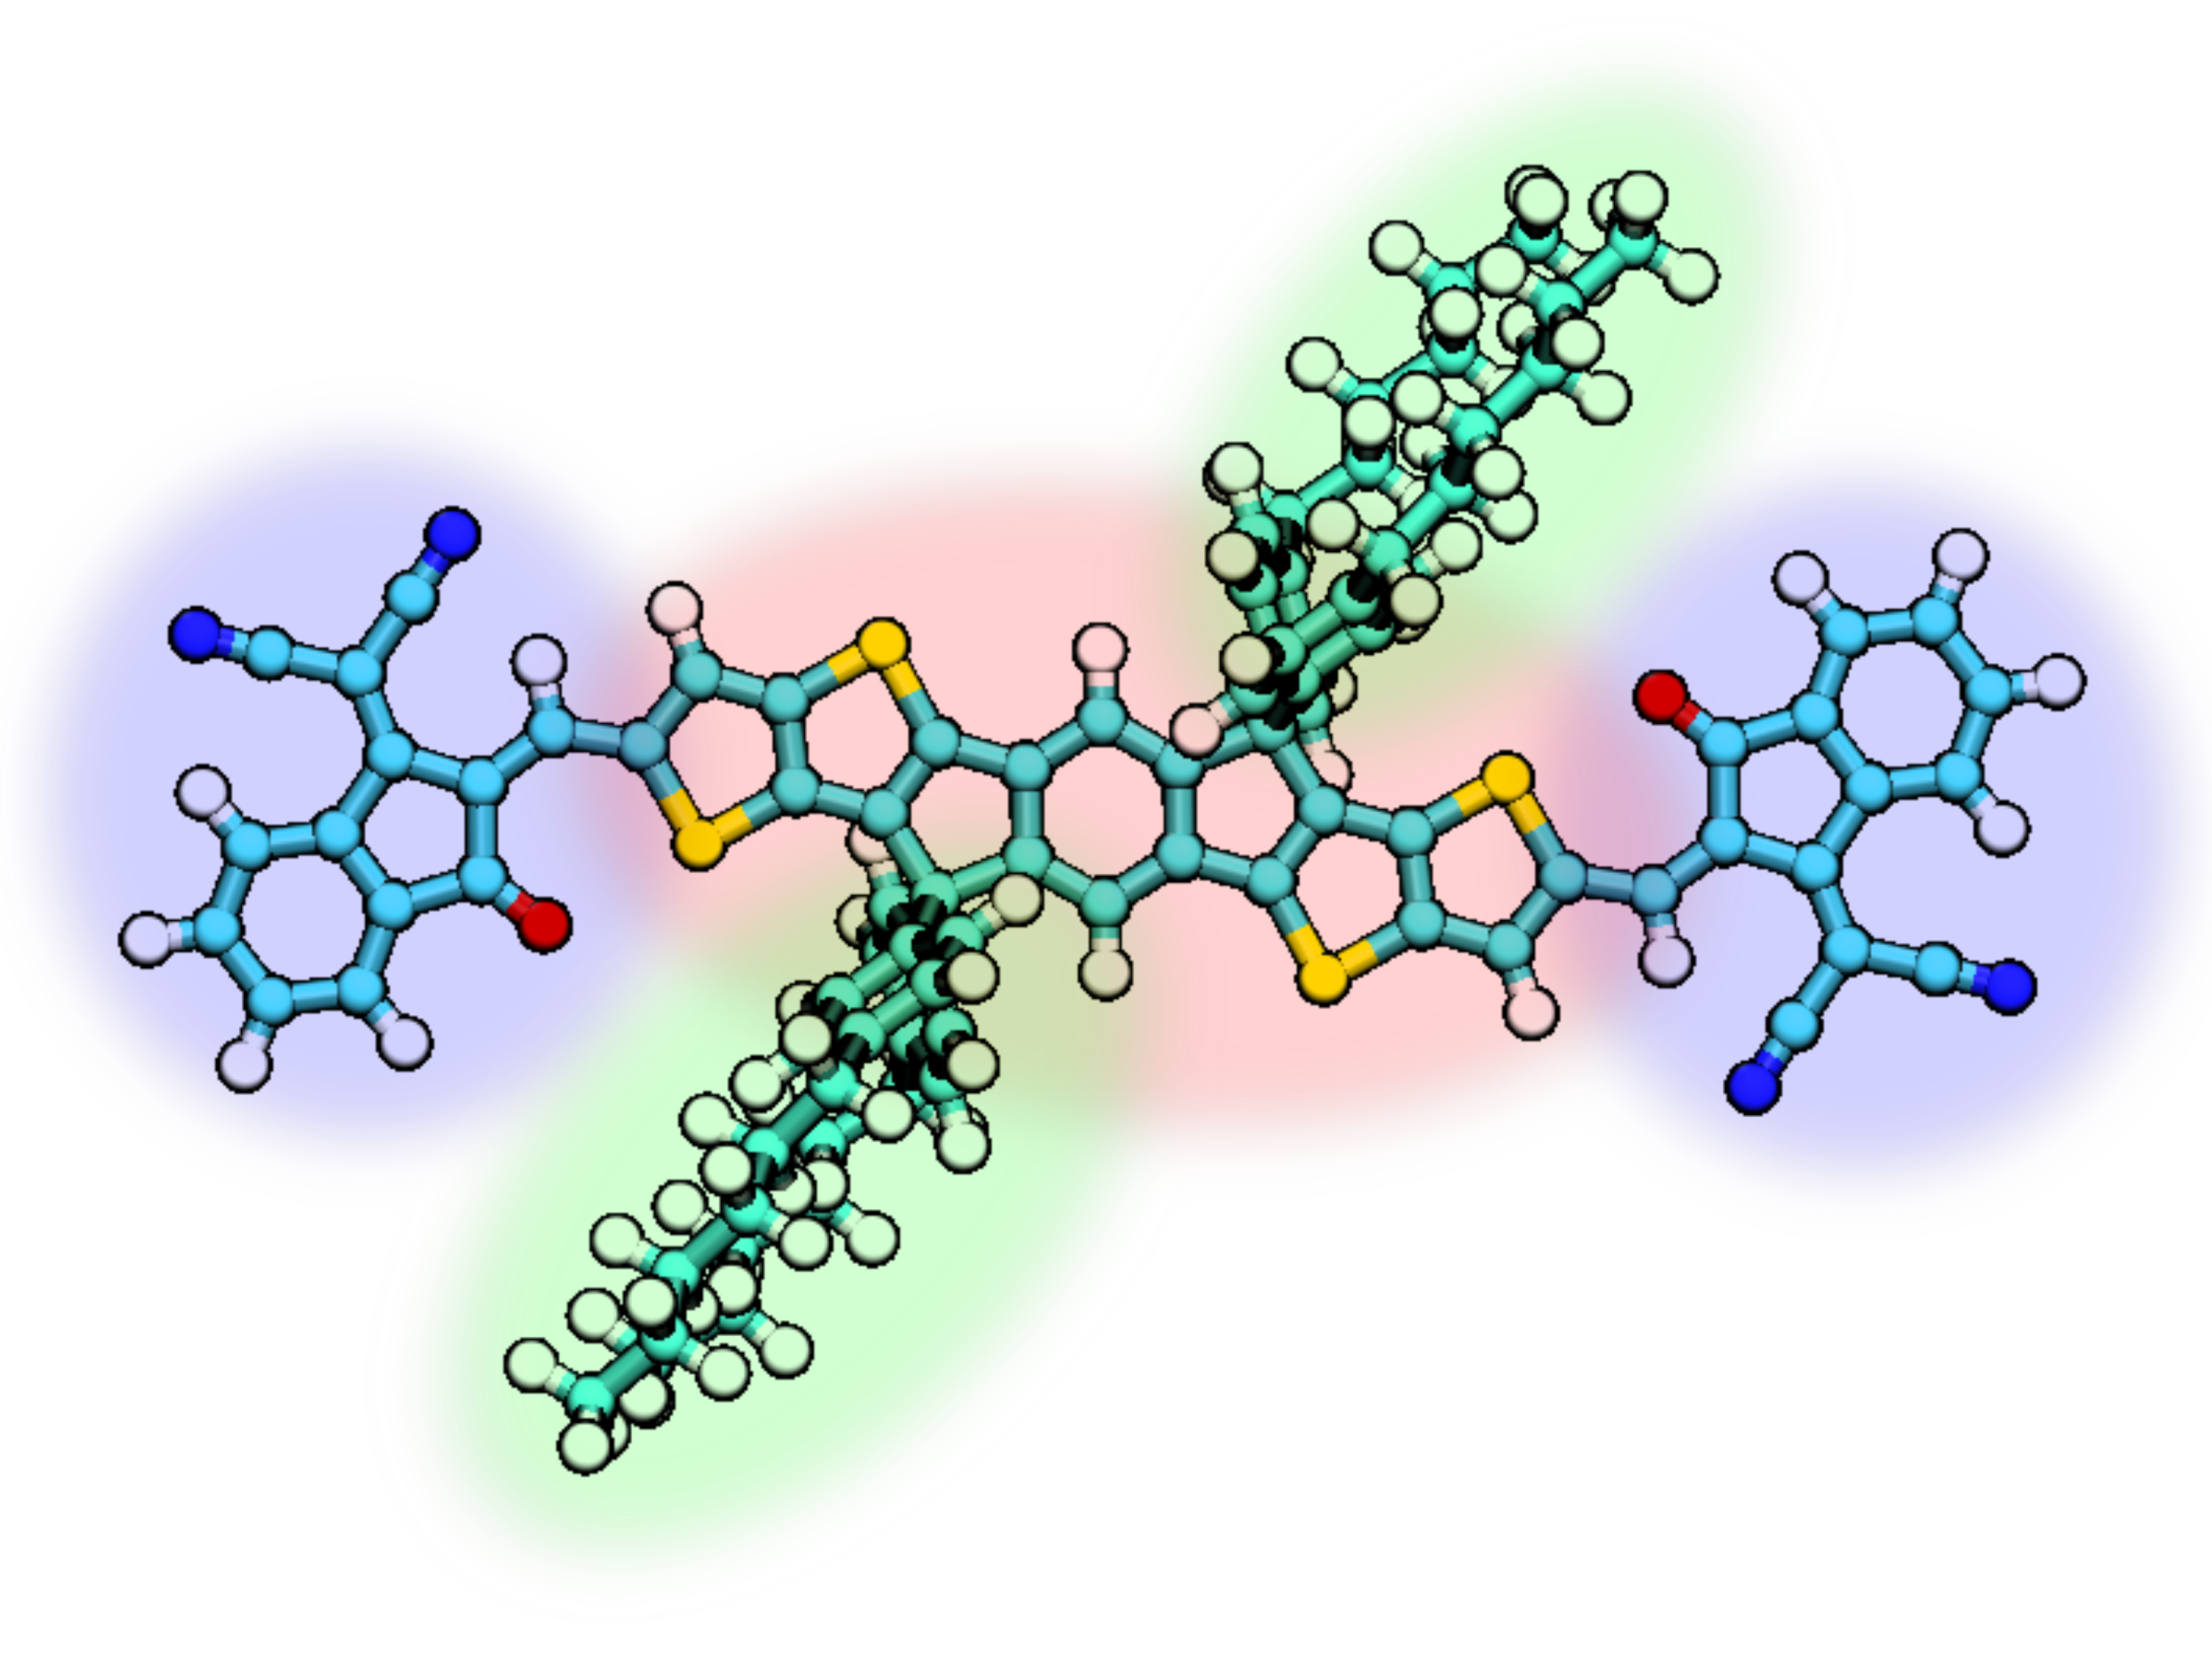
Fused-ring Electron Acceptors
ITIC
3,9-bis(2-methylene-(3-(1,1-dicyanomethylene)- indanone))-5,5,11,
11-tetrakis(4-hexylphenyl)-dithieno[2,3-d:2’,3’-d’]-s-indaceno[1,2-b:5,6- b’]dithiophene (ITIC).
Notes:
. It is composed of these macromolecules.
This construction, where we have distinct side chain moieties, fused ring core moieties and end group moities was proposed in 2015.
This modularity always for more plug and play engineering that resulted in device effeciencies inflating from 4% to 17%.
FOR EXAMPLE RESARCHERS FOUND THAT YOU CAN SWAP SOME HYDROGENS FOR A MORE ELECTRO MEGATIVE ATOM FLOURINE, WHICH CAN HELP OVERCOME THAT EXCITON BINDING ENERGY THAT I MENTIONED EARLIER.
So we have these two materials. What does it take to simulate them.

Slide 6
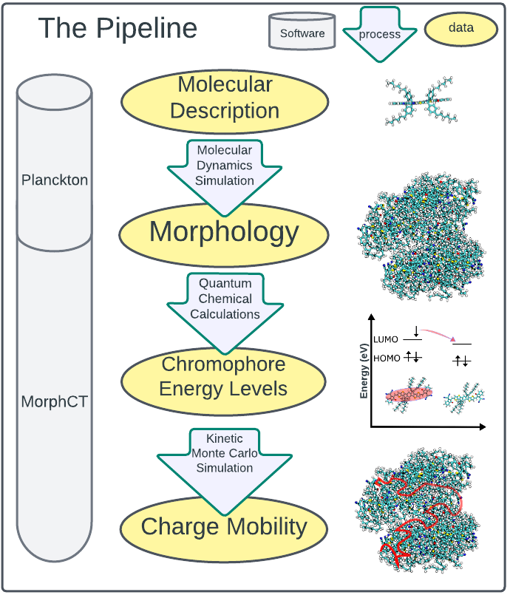
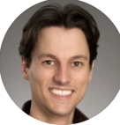
Notes:
MATTYS PIPELINE in great detail MATTY picture
Here we have the data pipeline through which we can take an atomistic representation of a material and graduate that iteratively to macroscopic material properties. This pipeline was proposed and described in more detail in matty jjones thesis who was member of our lab.
This is the pipeline through which we can transform these data sets through computation and simulation to arrive at material properties.
How do we simuilate these materials.
We start with a molecular description. This means writing down where the atoms are, the atom types and the bond that they are participating in. This also means writing down the interaction potentials between atoms. these can be non-bonded interatinon and iteraction potetnails for the bond distance and angle interactions and with that description you can run molecular dynamics simulations wherin you iteratively update the positions and velocities desrete intervale of atoms in the system with newtion calculus.
the interaction potentials with respect to all the atoms to obtain the force acting on all the atoms and update the velocities and positions. MD has shown to blah but how do describe the charge mobility ?
But given that this is an accurate prediction of this morpholgoy at the given thermodynamic state point how do we characterize the conductivity of this morphology.
We identitify segments where a charge is likely to localize and use quantum chemical methods to write down the energetics of a charge occupying the molecular orbital of those segments. We can relate those energies to the rate at which a charge can be expected to hop between all chromophore neighbors. Finally after writing down all the hop rates we can us those rates to run a kinectic monte carlo simulation to of charge propogation and keep track of how far the charges go and how long it took them to go there which gives us finally prediction for the mobility of charges in the system.
Thats a lot of wrinting things down along the way so we develop to packages for excecuting these methods
We begin with a description of the molecule, basically what atoms are where and what kind of bonds are they involved in.
We can then define bonded and non-bonded interaction potentials for the atoms in the system.
With that, molecular dynamics simulations involve chucking some molecules in a box together, pushing them in random directions, and evolving the system forward in time at descrete intervals by integrating over the interaction potentials in a newtian way. Molecular dynamics has been shown to accurately predict morphology.
keep up with how far he has gone and how long it took him to go that far

Slide 7
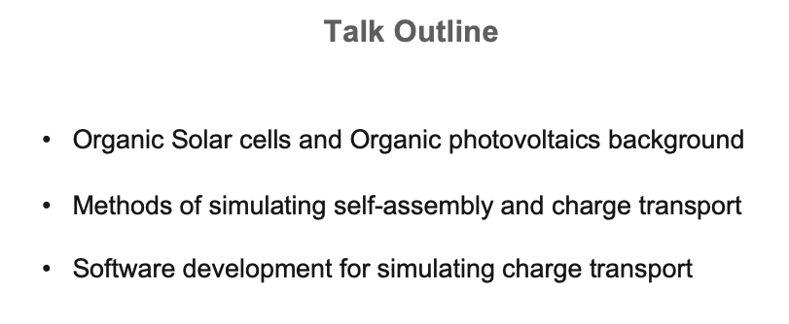
Notes:
Here we have the data pipeline through which we can take an atomistic representation of a material and graduate that iteratively to macroscopic material properties.
This is the pipeline through which we can transform these data sets through computation and simulation to arrive at material properties.
We begin with a description of the molecule, basically what atoms are where and what kind of bonds are they involved in.
We can then define bonded and non-bonded interaction potentials for the atoms in the system.
With that, molecular dynamics simulations involve chucking some molecules in a box together, pushing them in random directions, and evolving the system forward in time at discrete intervals by integrating over the interaction potentials in a newtian way. Molecular dynamics has been shown to accurately predict morphology.
keep up with how far he has gone and how long it took him to go that far
Before we talk about the devepment that I have done on morphCT we need to take a quick detour into the theory the underlies morphCT in a little more detail. To run a kinetic monte carlo simulation we need the rate of all possible events in the system. In out case, the events are hops to new chromophore.

Slide 8
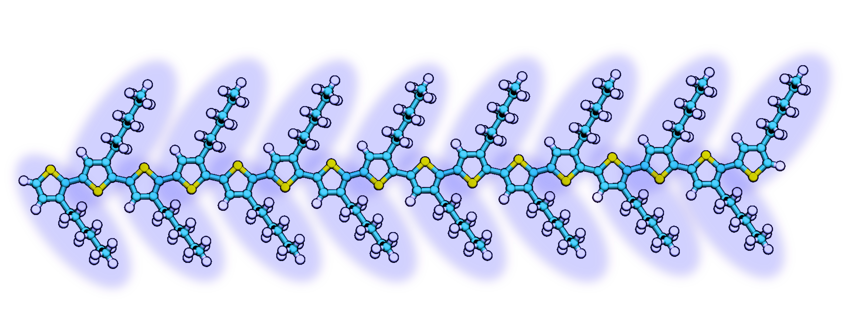
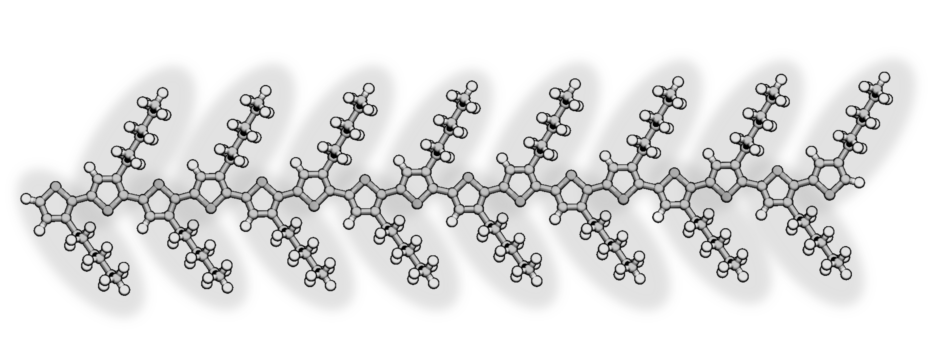
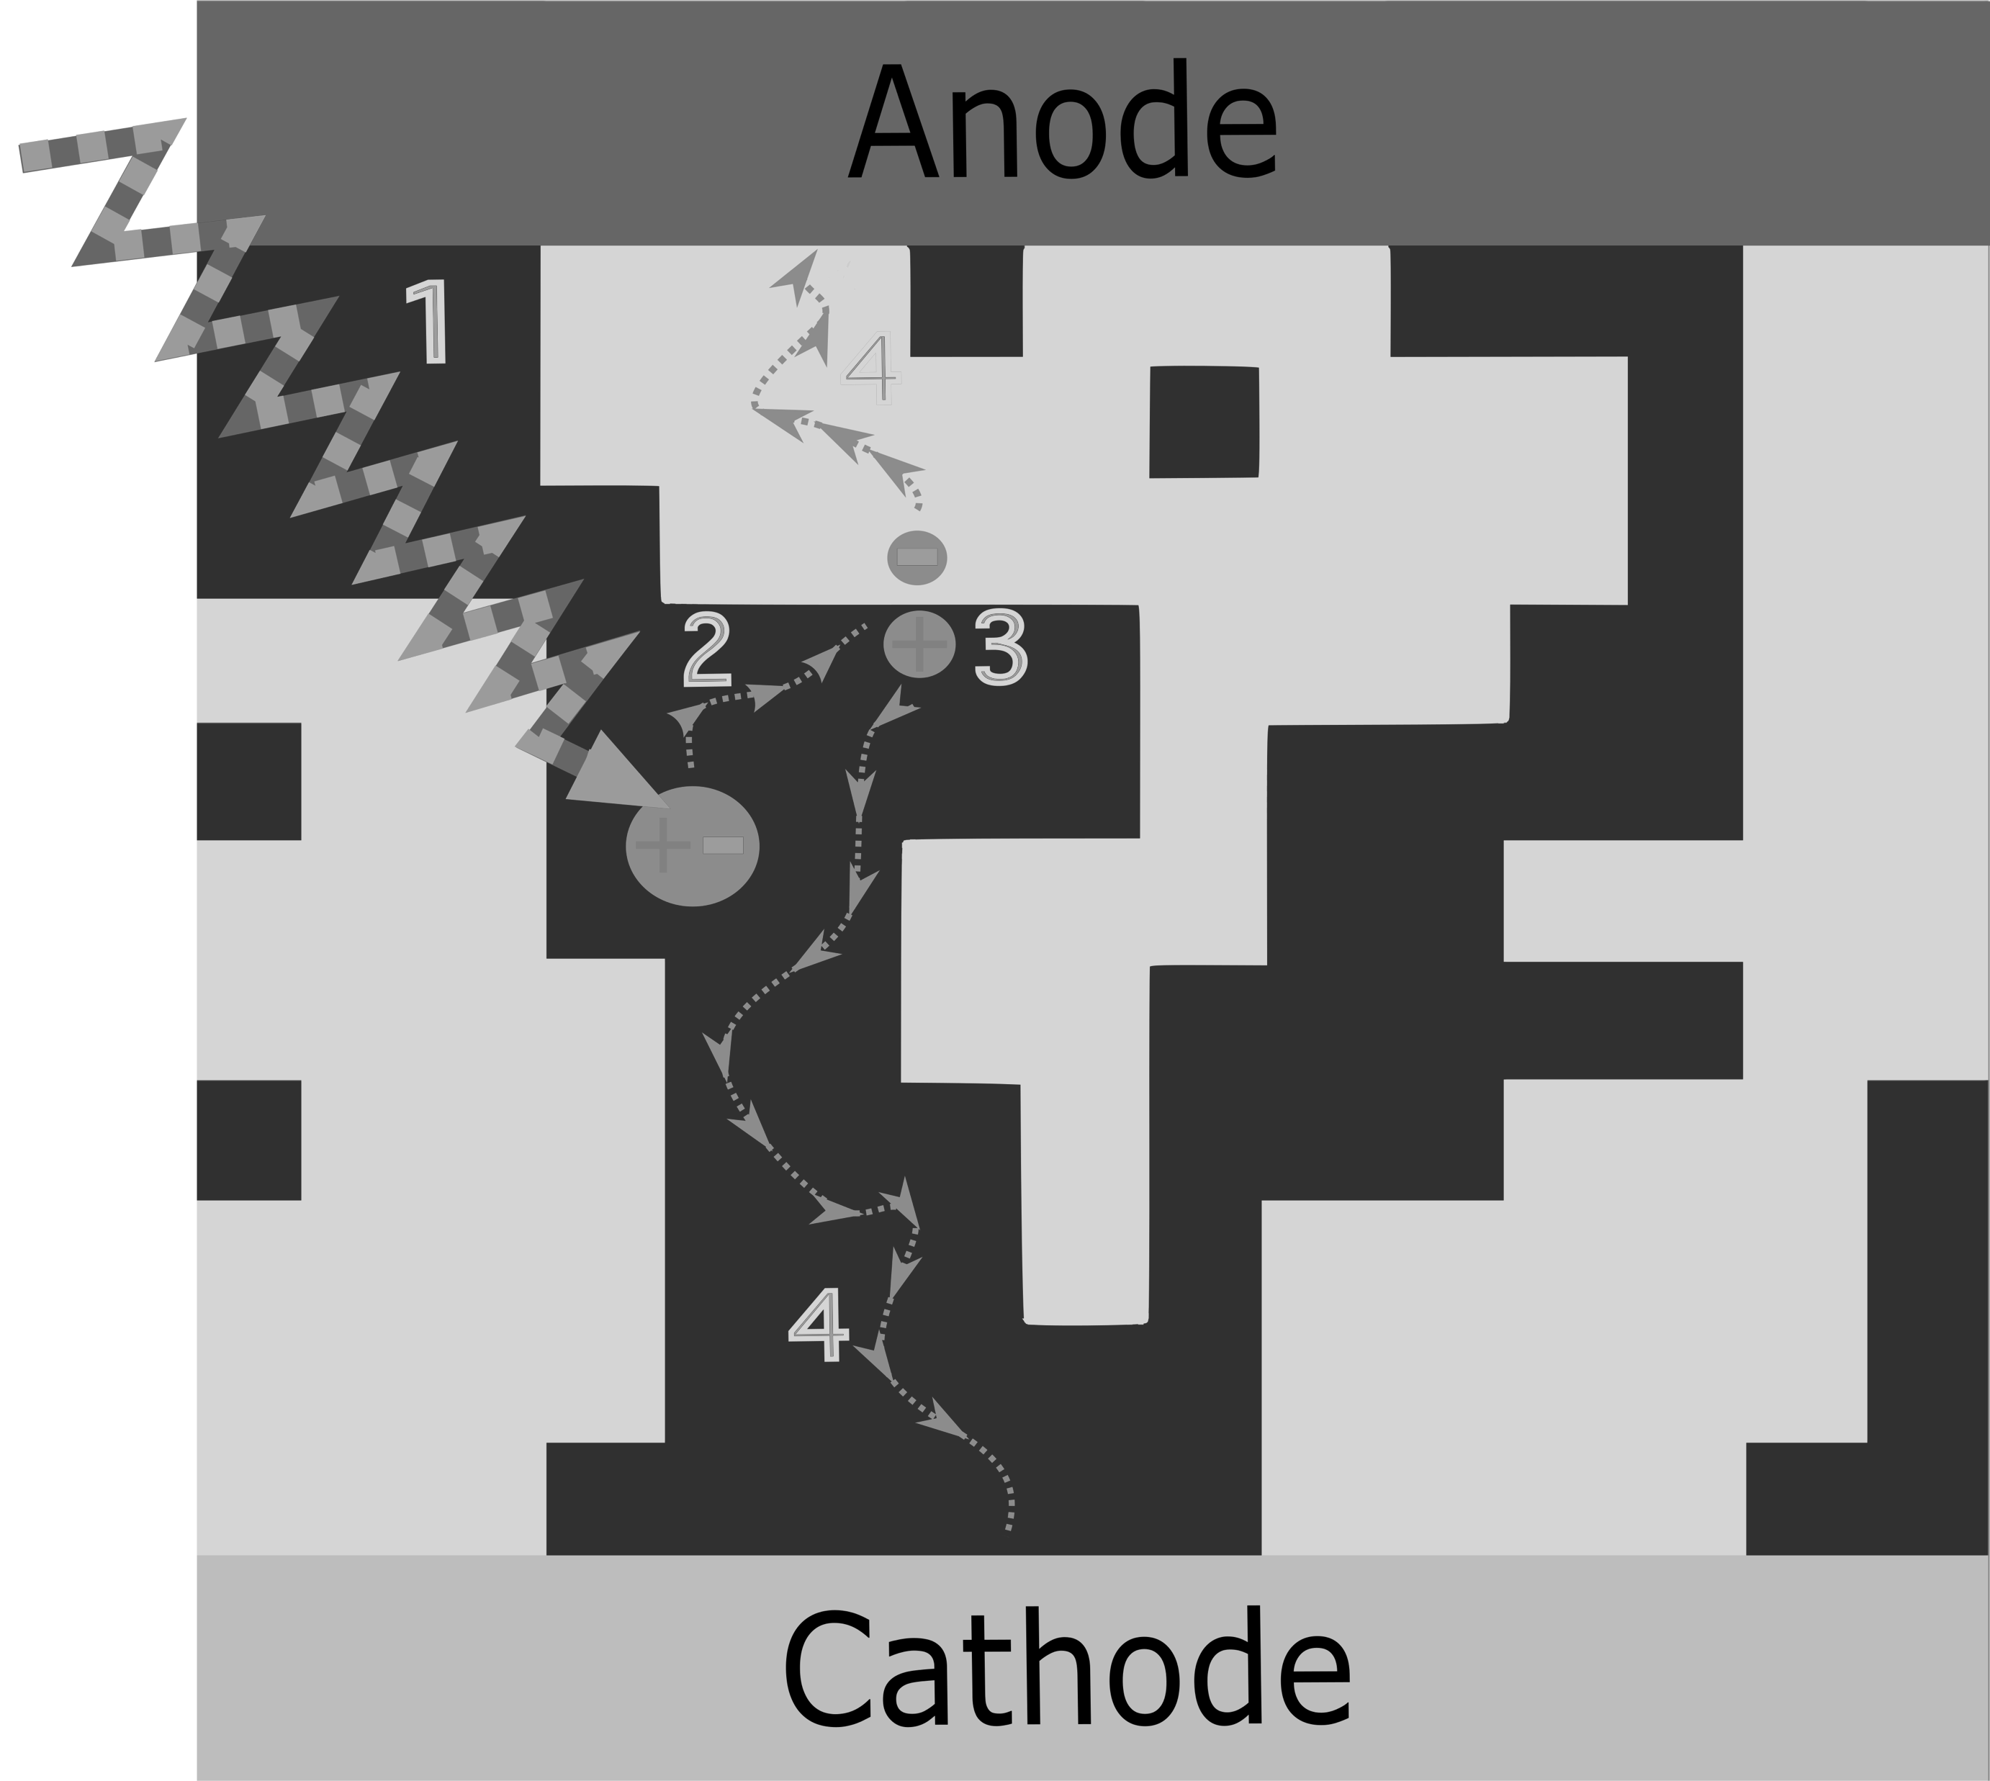
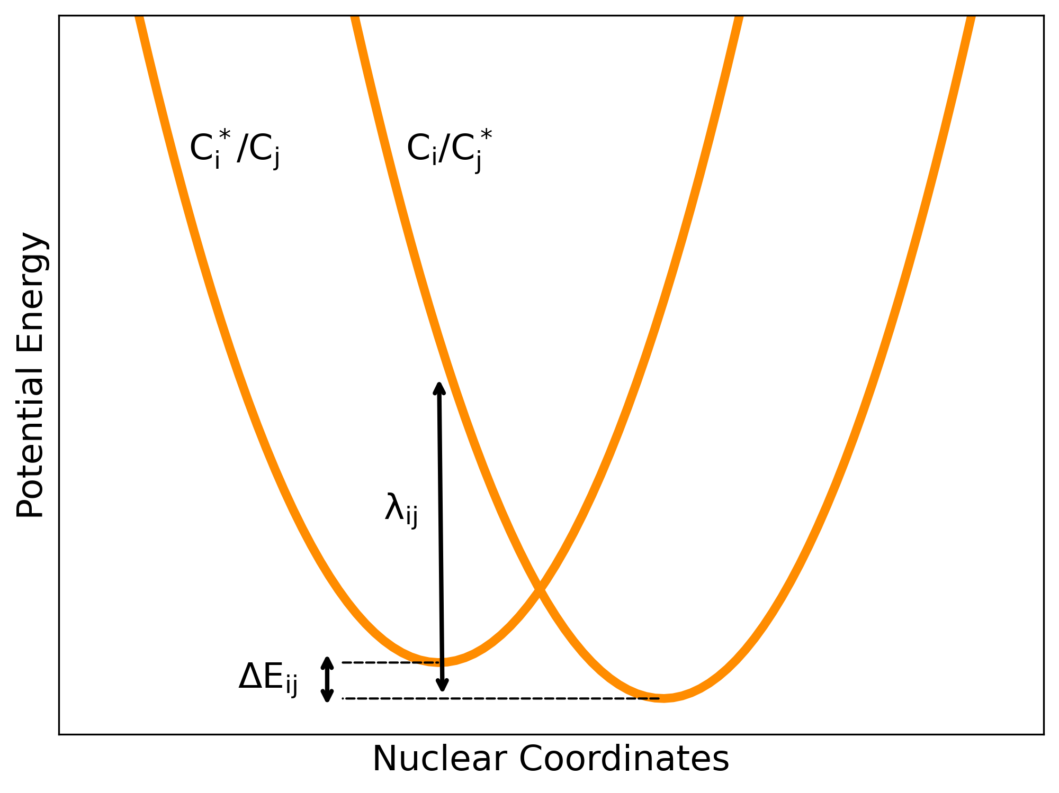
Chromophores?
Notes:
How do we go from energies to a rate ? because if we know the rate for each hop, we can take the inverse of that to be the amount of time it took it to hop.

Slide 9
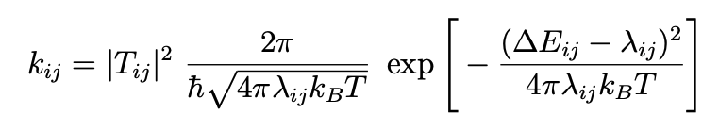
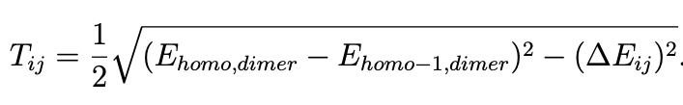
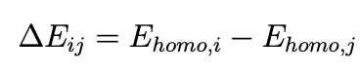
Chromophore energy levels give the hop rate.
v
Marcus model
Notes:
STICK TO THE SCRIPT
Marcus theory of electron transfer reactions gives this rate as k, seen here.
MENTION THE CONSTANTS
From this description of all possible hops BETWEEN NEIGHBORING CHROMOPHORES in the system we can use a kinetic monte carlo algorithm to arrive at a charge mobility calculation.
With electron transfer taking place much much faster than change in nuclear coordinates (franck-condon princilple) , we can model a hop as a thermally activated processes with the intersection occurring at the intersection of the

Slide 10
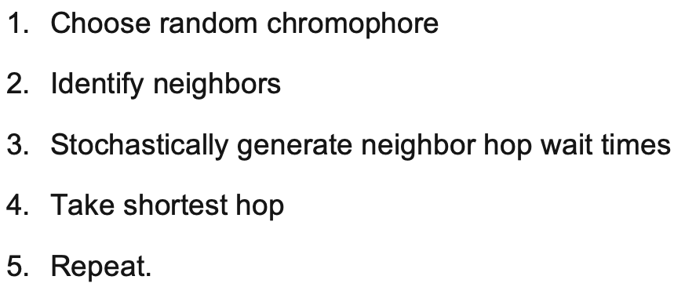
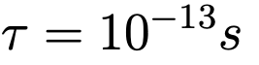
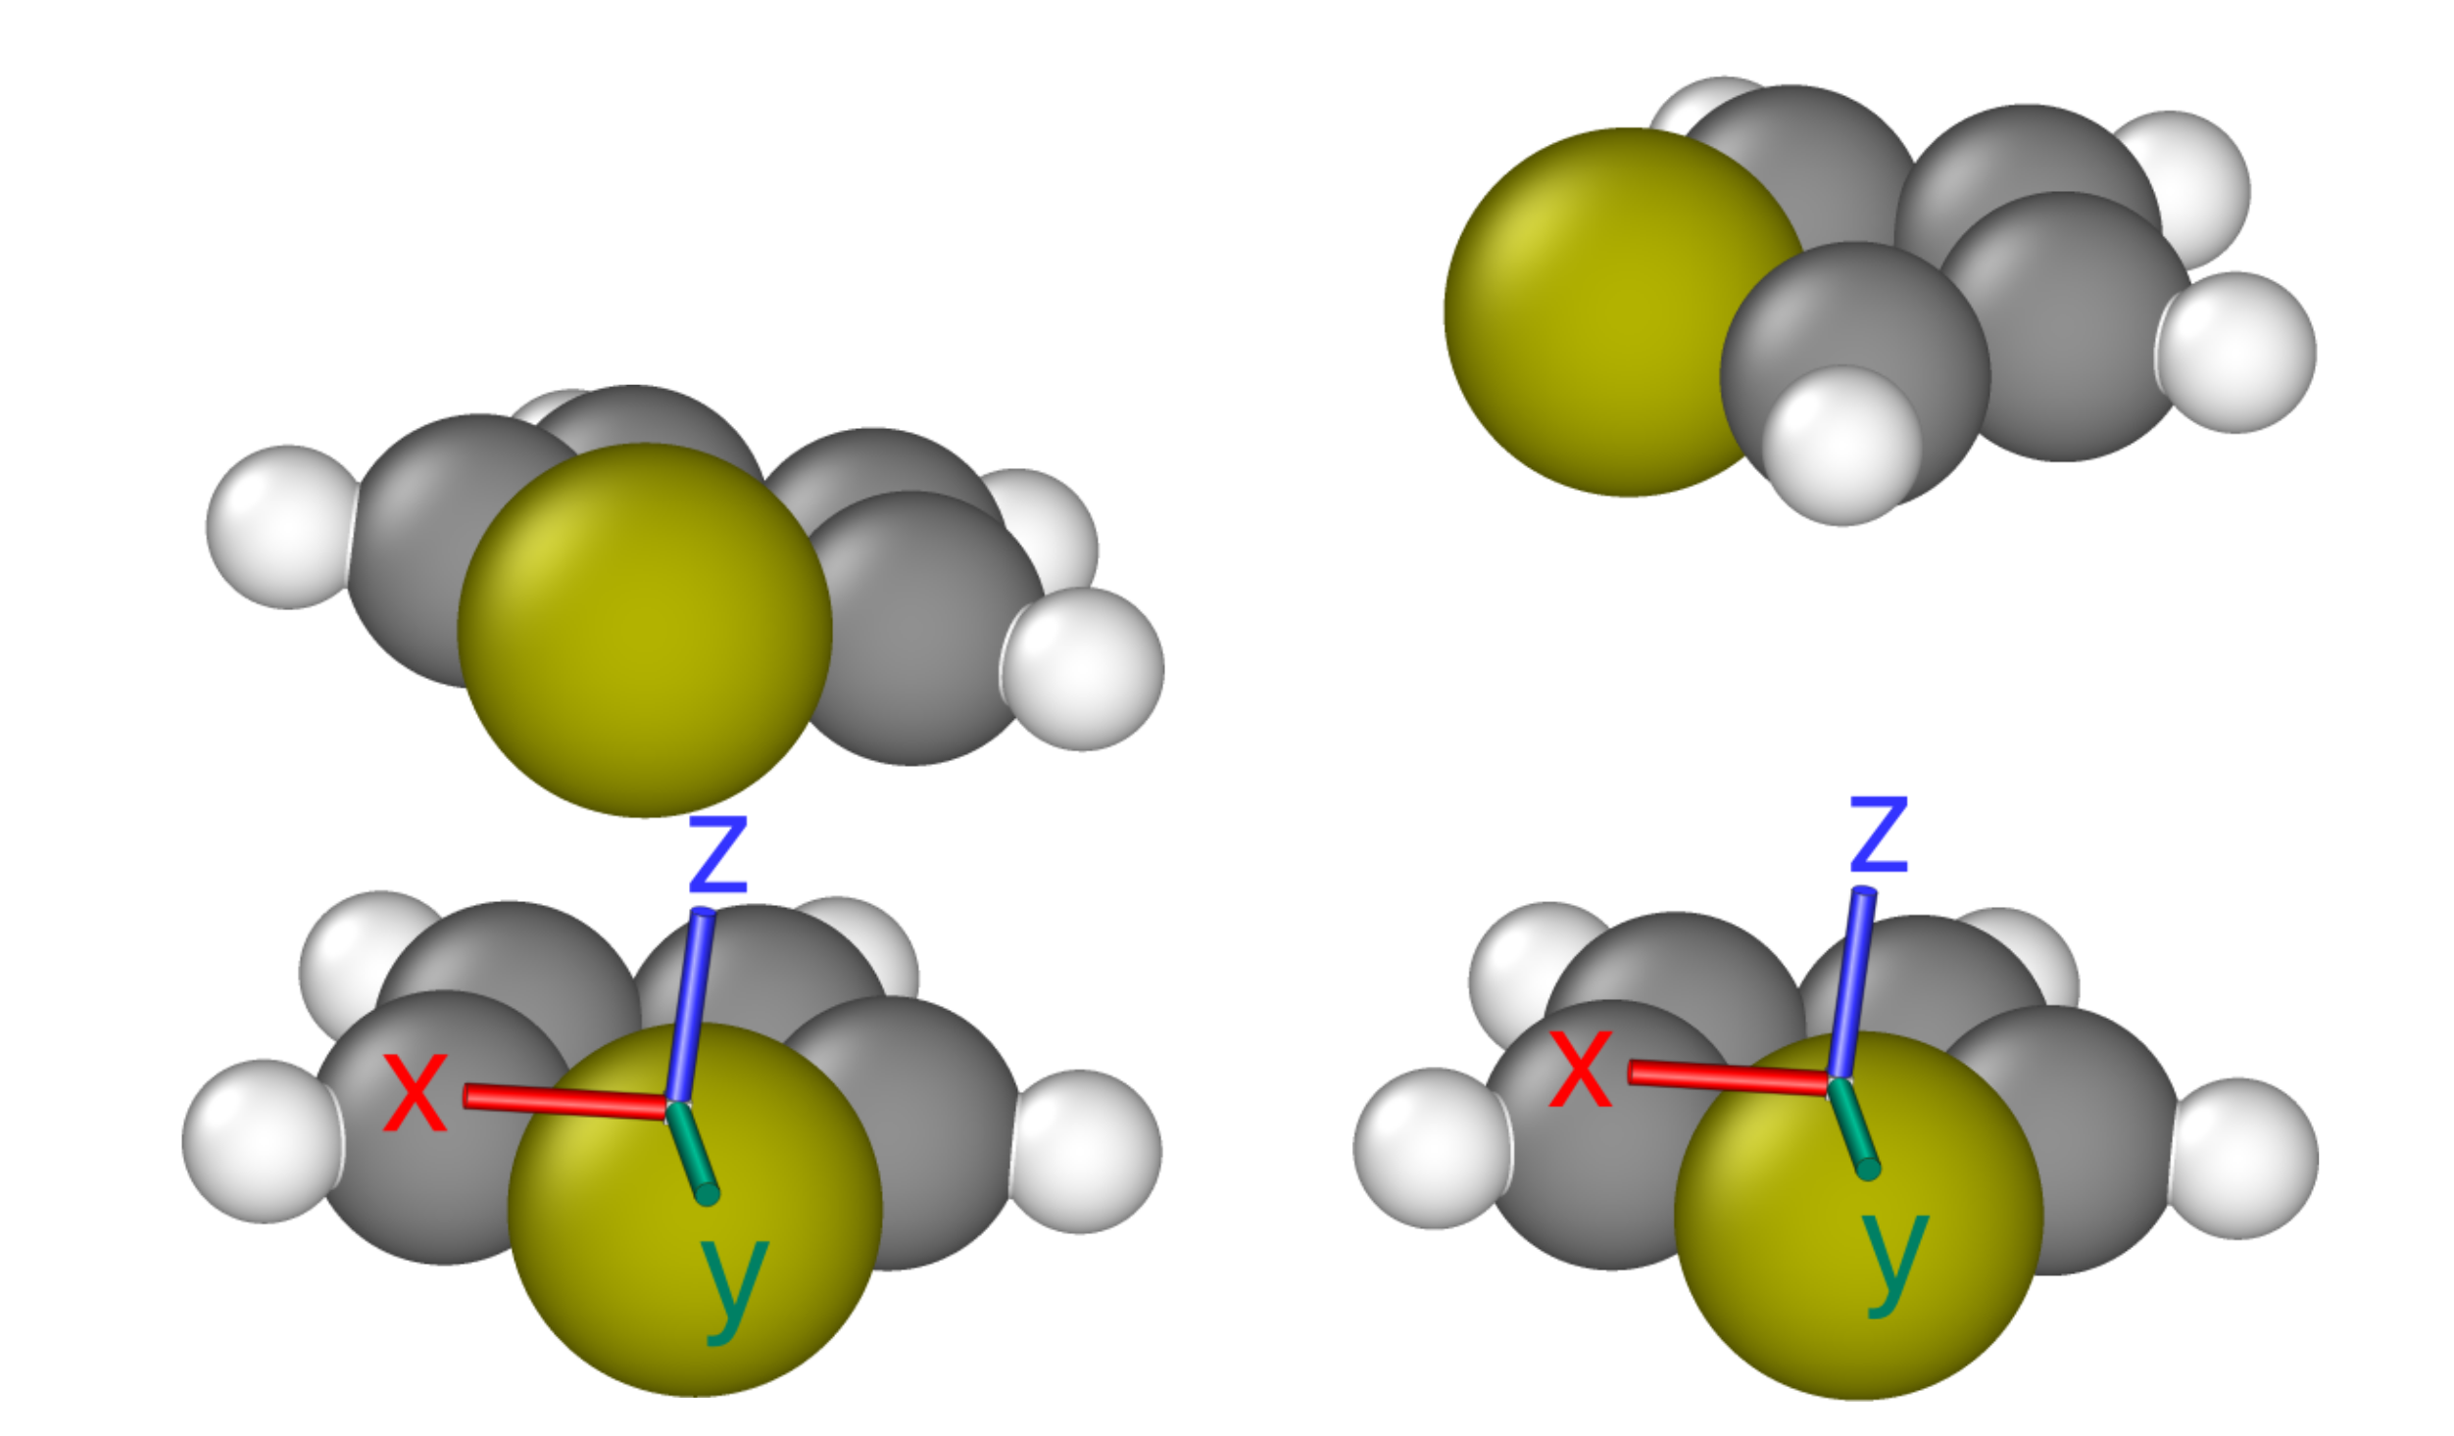
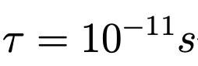
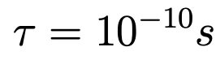
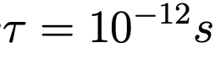
Kinetic Monte Carlo algorithm based on the Marcus rates
Notes:
A core tenet of Monte Carlo sampling is ensuring a large sample size. With a large enough sampling, significant reshuffling of the queue will take place, allowing for a rare hop to jump the queue. For example, a charge carrier that hopped a million times, and had exactly 5 neighbors at each hop, would require forming a million wait time queues and 5 million individual wait time calculations. Shuffling each wait time by ln (1/x), we can expect to see ∼50 wait times that have been shortened by 5 orders of magnitude, ∼500 shortened by 4 orders of magnitude, and so on.
WE REPEAT UNTIL THE CHARGE HOPS PAST A SPECIFIED LIFETIME
So this can model an individual charge carriers movement through a morphology, but how do we aggregate this information statistically to arrive at a charge mobility prediction?

Slide 11
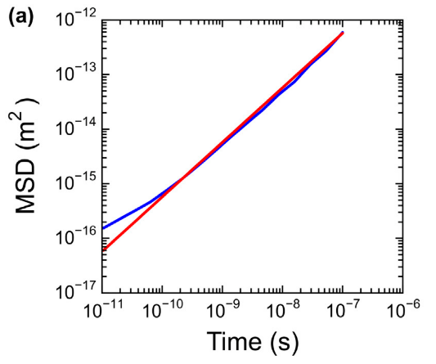
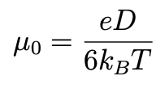
From charge trajectory to MSD to diffusivity to mobility.
The diffusivity, D, of a free charge walking randomly through this electronic environment is given by the slope of the Mean Squared Displacement (MSD).
Charge mobility is then given by the following Einstein-Smoluchowski relation:
Jones, M. L., & Jankowski, E. (2017). Computationally connecting organic photovoltaic performance to atomistic arrangements and bulk morphology. Molecular Simulation, 43(10-11), 756–773. doi:10.1080/08927022.2017.1296958
Notes:
we aggragate the data from 1000's of charge propigation simulations by tracking the standard deviation in position of all the charges. The slope of this standard deviation, or MSD, as time goes to infinity gives the diffusivity of a charge walking randomly through this electronic enviroment. Finally, we can relate the diffusivity to charge mobility with the einstien relation.
choosnig the range that we use to calculate the the slope is underspecified. how long we choose to simulated and do this MSD analysis for are model choices. the edge lifetimes can impact the MSD analysis and there for mu.
There is no objective best practice for determining the slope of the MSD as time goes to infinity from simulation data of this kind [? ]. But I am going to show some results from mobility values that result from various approaches.
we intitialize thousands of charges to make sure that we a sufficiently sampleing the morphology and . by averaging over the trajectory of all the charges and we can summarize this as a MSD plot
In my analysis I found that using two checkpoint or charges carrier lifetimes to be sufficient for fitting this slope because we are averaging over thousand of individual carrier.

Slide 12
MorphCT
A package for running and analyzing KMC simulations
Replaced ORCA with PySCF for QCC
Validate that PySCF works at the chromophore level
Validate and perform sensitivity analysis using a benchmark P3HT morphology
Deploy the pipeline from scratch on ITIC
Development
Notes:
As I introduced earlier, MorphCT is a package for BLAH. When matty first wrote morphCT it used a package called ORCA to perform the QCC. Unfortunatly ORCA was inhibiting the scripting of MorphCT because it requires a licensing agreem be signed. When I began working on morphCT, jenny, who many of you may have seen defend her dissertation last week was in the process of stripping ORCA out for PySCF.

Slide 13
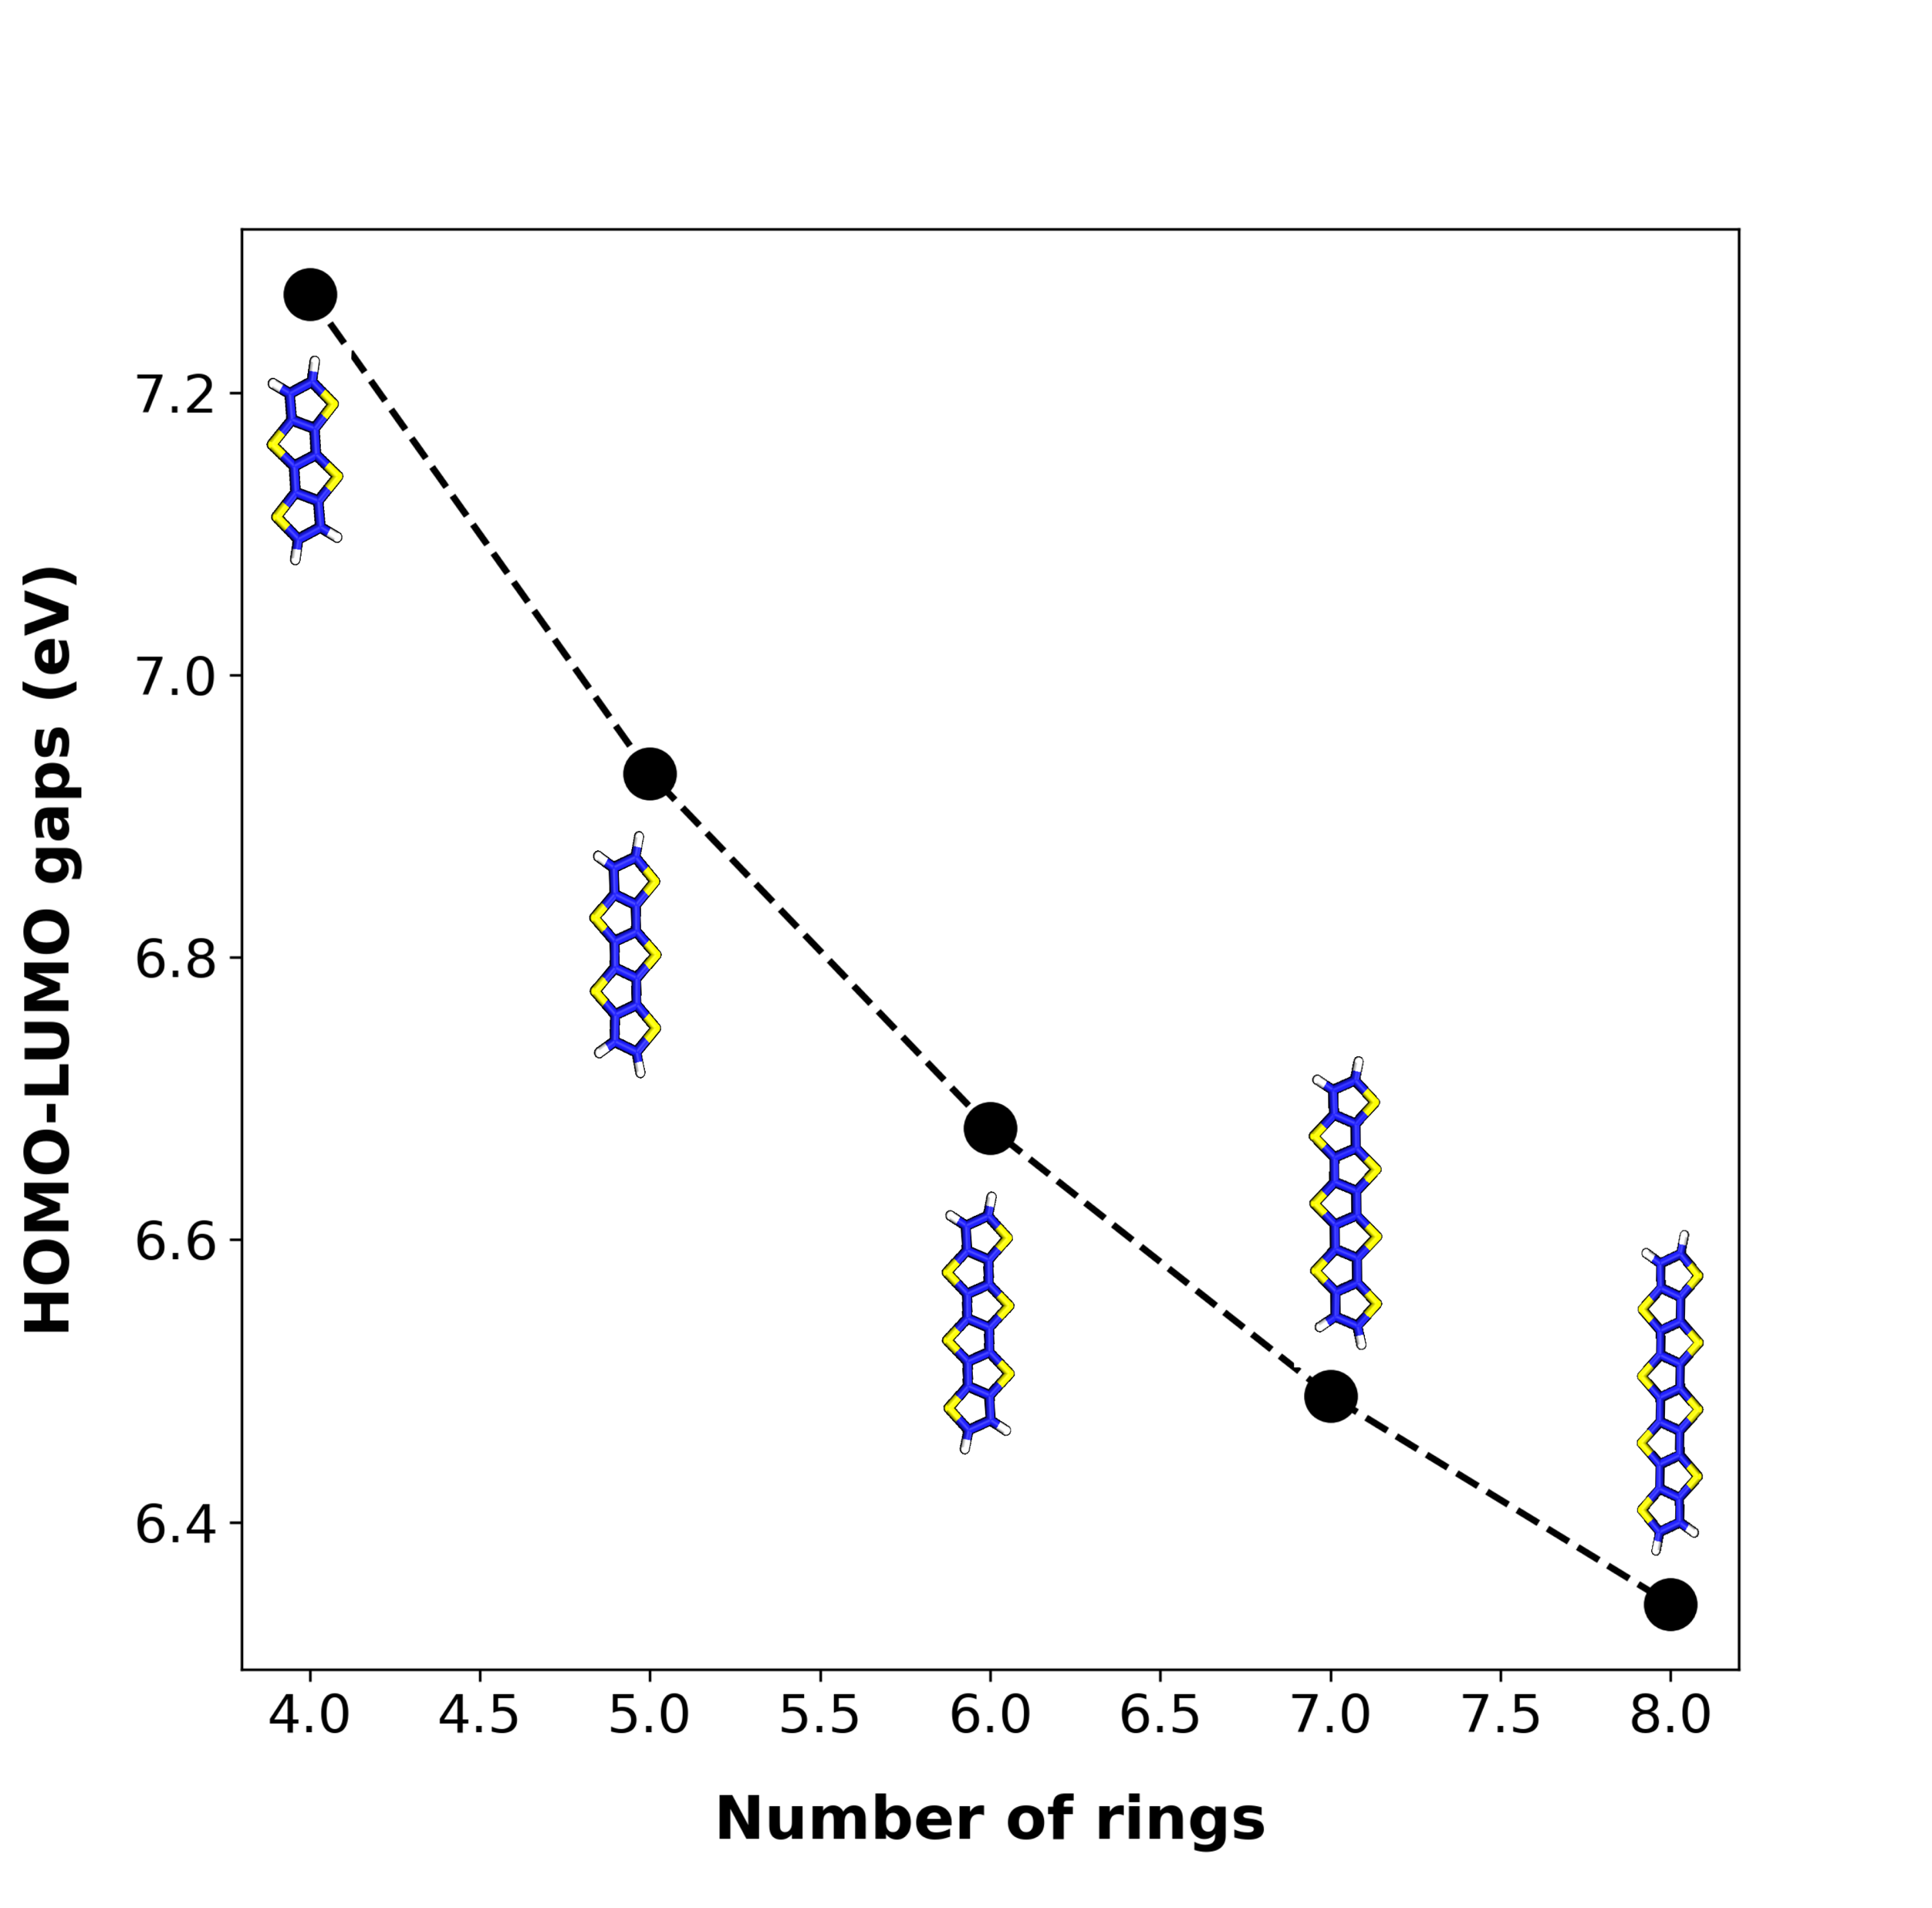
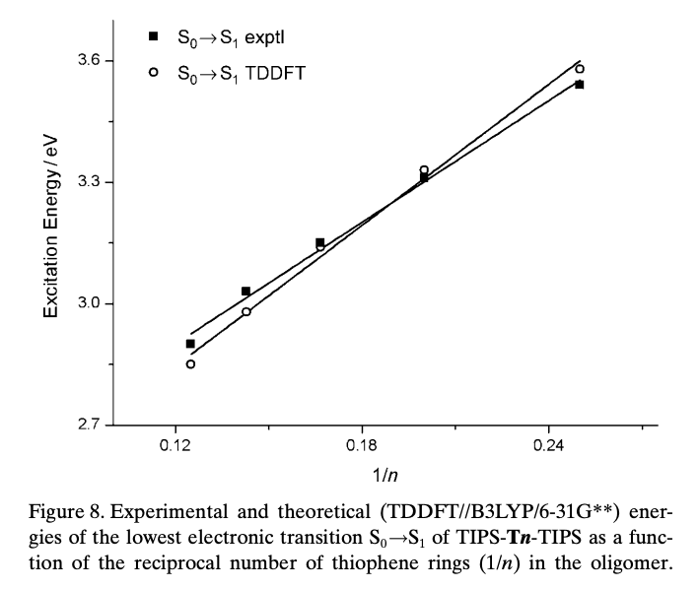
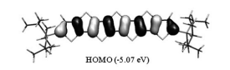
Validate molecular orbital energy level calculations
10.1002/chem.200903343c
10.1002/chem.200903343c
MINDO/3 (PySCF) HOMO
Ab initio DFT HOMO
~5eV
~6.8eV
Notes:
To test the performance of PySCF at the level of the chromophore, I reproduced this study done with more precise Quantum chemistry to see if we can reproduce the trends.
Estimation the charge carriers energy levels means estimating eigenvalues of the time-independent Shrodinger equation corresponding to the HOMOs of chromophore i and j respectively
In our work, these values are approximated with the MINDO/3 method, a variation of the intermediate neglect of differential overlap (INDO) method. This method seeks recreate the ab initio Hartree-Fock results, where Hatree-Fock theory allows for an iteratively convergent numerical solution to the Shrodinger equation [? ].
We have validated that we replicate the well studied trend that homo-lumo gap decreases with monomer length.
So we are pretty sure that it is self consistently estimation appropriate energy levels. Then we did a little experiment to see if the electronic coupling between chromophores is being well approxiamated.

Slide 14
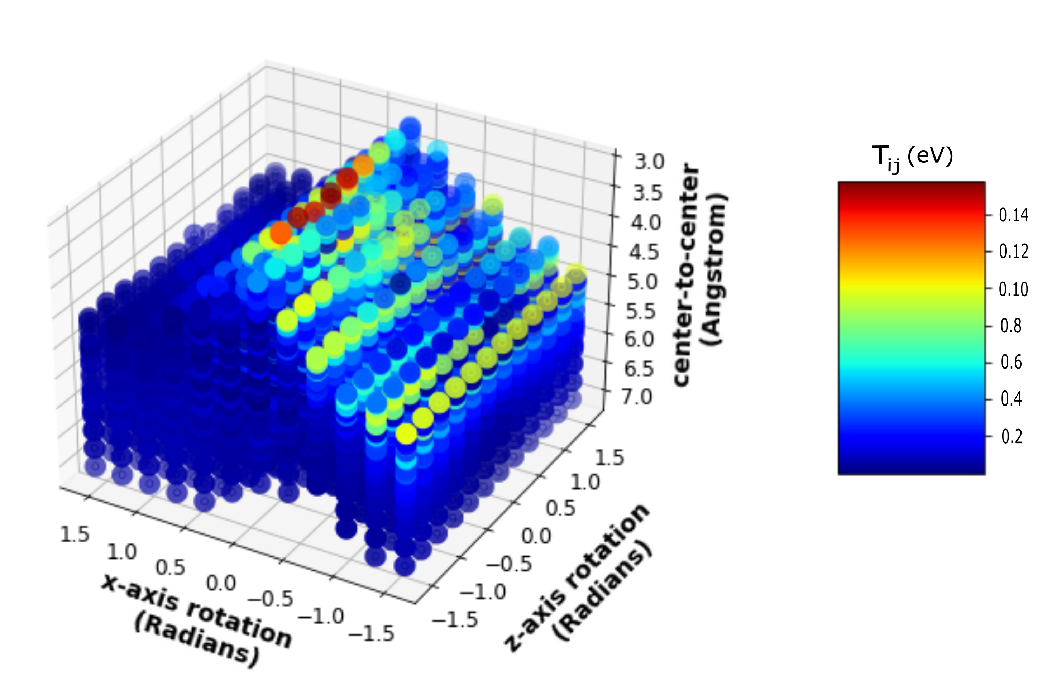
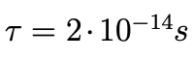
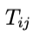
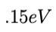
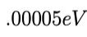
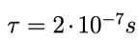
Validate electronic coupling calculation
Notes:
low transfer intergal low electronic coupling.
(a) Individual dots correspond to 5680 distinct combinations of rotations and translations of the upper thiophene. Orientations resulting in atoms that were less than 0.3nm were removed from the data set as distances shorter than this are considered unphysical.
These calculations match closely those calculated using more rigorous ab initio DFT methods[? ], where realistic distances between thiophene rings in lamellar P3HT crystals between 0.38nm and 0.4nm gives Tij values between 0.07eV and 0.1eV
LEFT: The orientation (x-axis rotation ∼0.14, z-axis rotation ∼−0.14, center-to-center ∼3.2) with the hightest Tij. RIGHT: The orientation (x-axis rotation ∼ − 0.14, z-axis rotation ∼ − 1.5, center-to-center ∼5) with the lowest Tij
A reference thiophene was placed at the origin in the xy-plane with the y-axis
running through the sulfur atom as shown in Figure 2.6(a). For the second thiophene,
two sets of 12 rotations about the x-axis and z-axis (with − π < θ < π ) and two sets
of 12 translations between 0nm and 0.5nm along the x-axis and z-axis were defined. The Cartesian product of these sets define a space of 124 = 20736 orientations for second thiophene.
Orientations resulting in atoms that were less than 0.3nm were removed from the data set as distances shorter than this are considered unphysical.

Slide 15
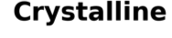
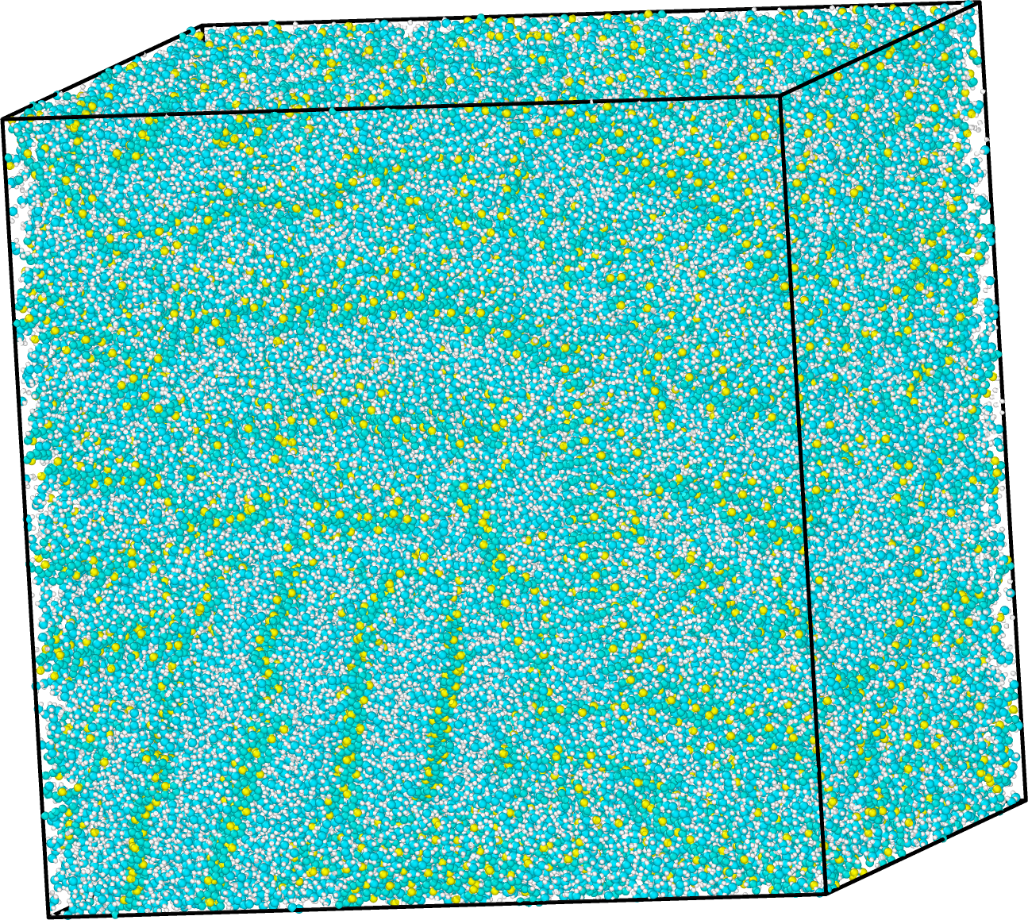
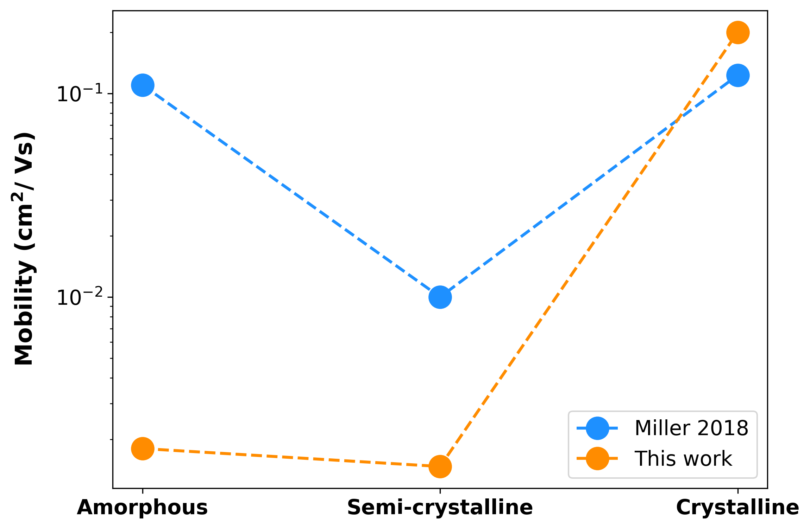
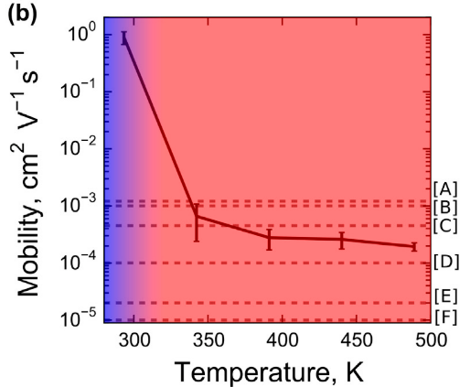
Validate entire implementation
Notes:
Need to do further validation to see how the trend matches with polydisperse morphology.
After validating that the new software stack and current workflow works at 3 levels of resolution.
say: 1 the crystallung mobilities are highter than amorphous in both works. 2. the semi crystalline are the lowest with both and thats expexted because have disconnected crystalls and lowers mobility. some differnces our amorphous stuff is lower than thiose from evan. more work to be done to figure out which ones more right. but we doo know that we are captureing the morphology in our mibiility predictions. And having this pipeline ironed out will help us dig into this.
10^-1 approaching band like transport speeds.

Slide 16
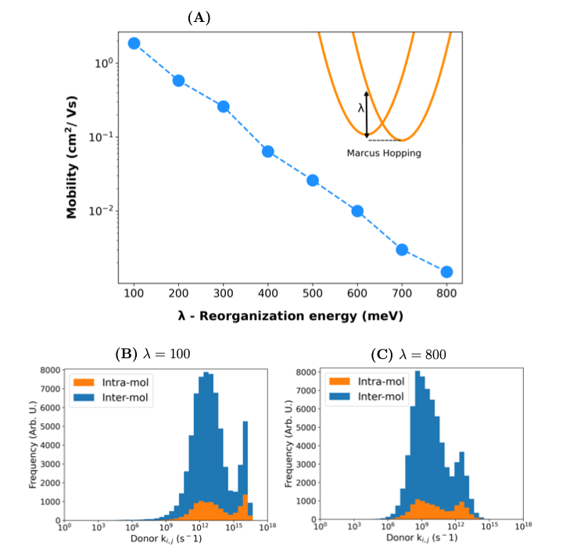
Mobility sensitive to reorganization energy
Notes:
progress needed to calculate lambda from scratch and as it may differ from molecule to molecule.

Slide 17
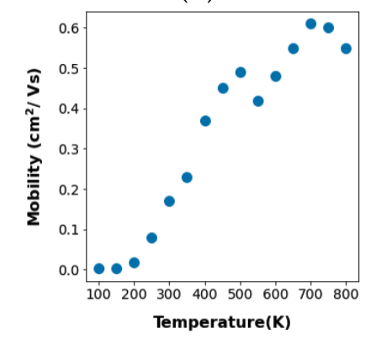
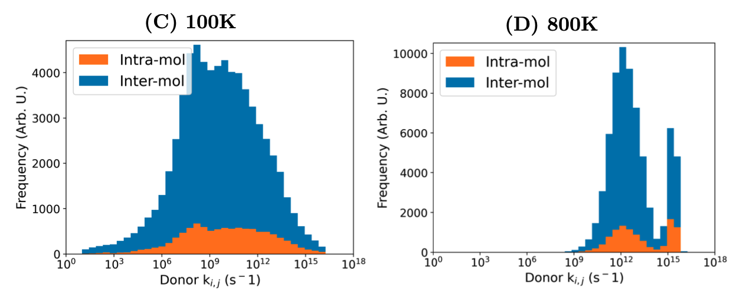
Mobility less sensitive to temperature
Notes:
temperure lowering barrier activation energyer
mention 8X temp only increase mobiliity by 6 vs orders magnitiude for la
neglidgligble compared to lambda
Glass transition melting point

Slide 18
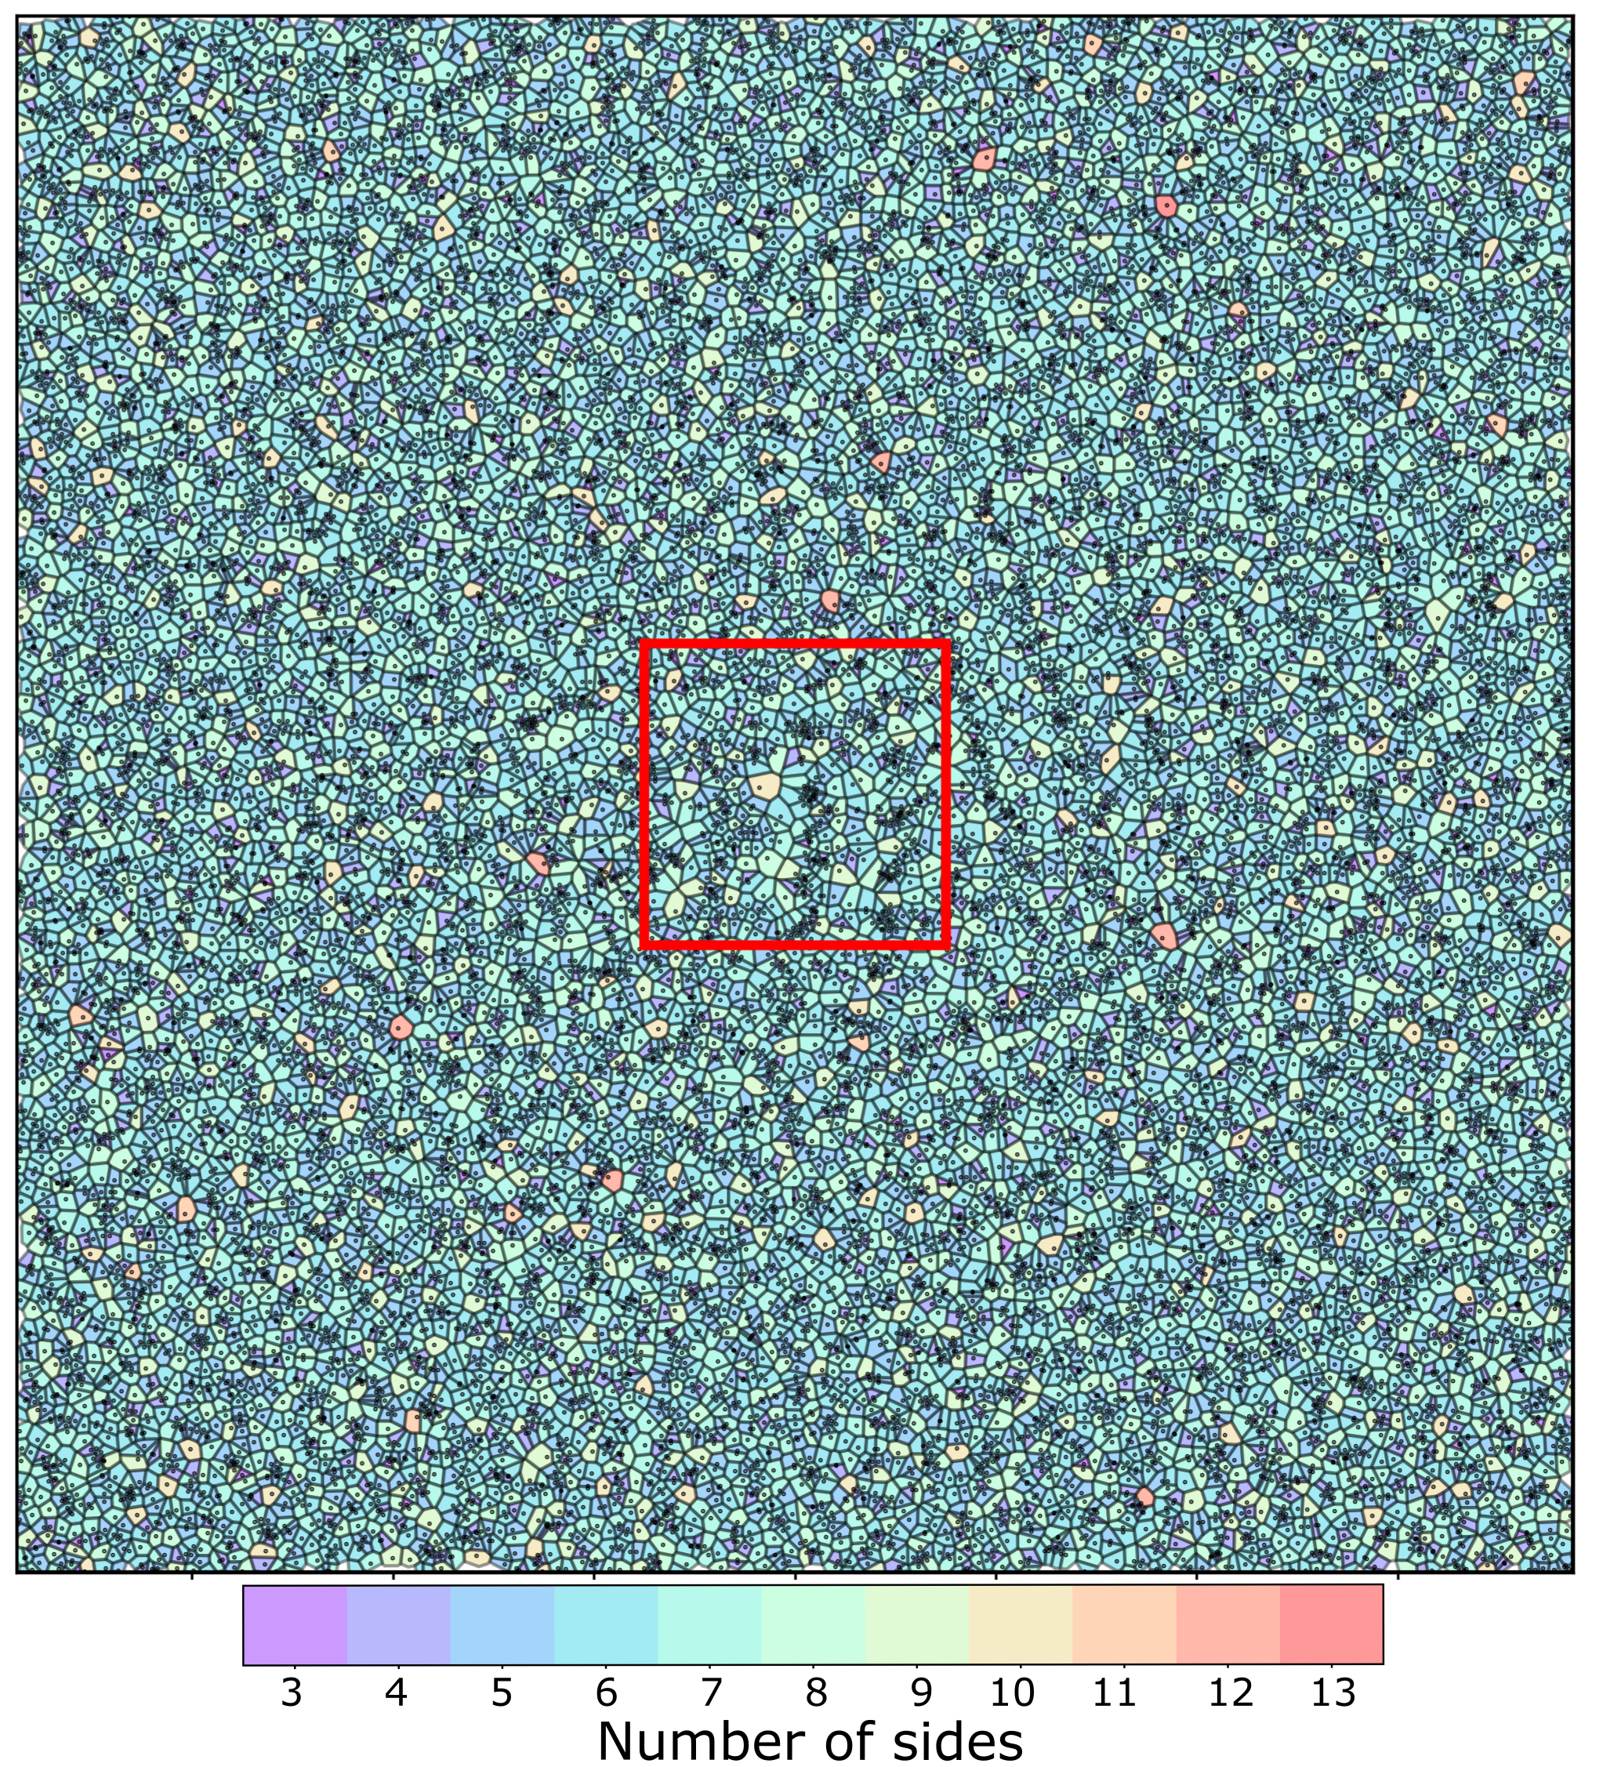
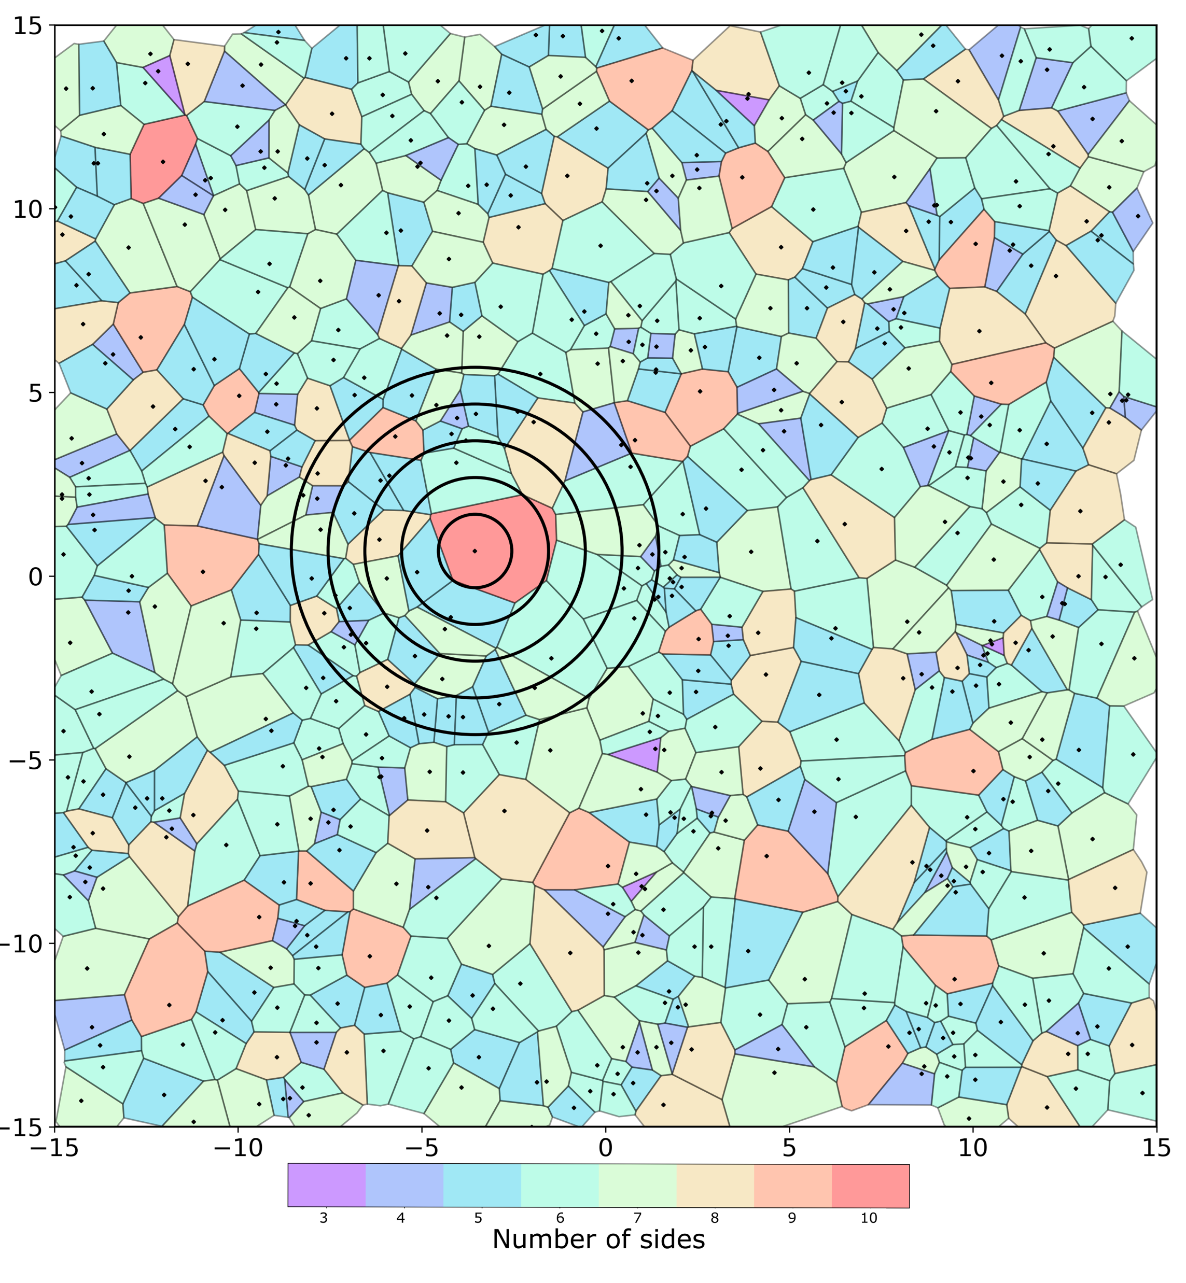
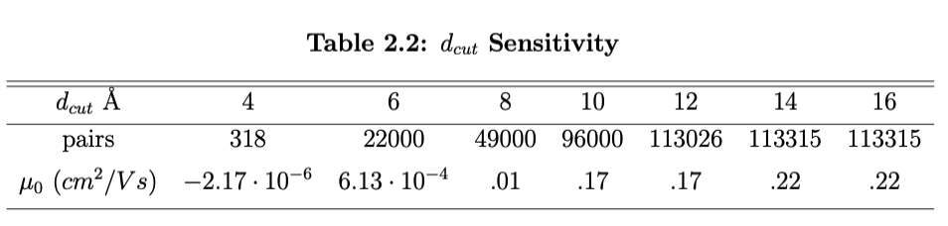
Voronoi neighbors sufficiently efficient
Notes:
Remembering that we calculate all hop rates between neighbors .We build neighbors using Voronoi analysis. Space searching algorithms like this are known to scale linearly with system size as
An artifact of buildeing neighborlist in this way is that you can sometimes BLAH
SAY HOW MUCH TIME IT TAKES .
are you saying that if we only consider voronoi how many neighbors.
for the plot: truncating voronoi neighbors of long distances can only make things worse dont throw any voronoi neihgbors away.

Slide 19
Notes:
To apply the pipeline to ITIC I used the template simulation scripts provided by planckton and ran a 1000 molecule simulation on our high performance cluster here at boise state called FRY.
Took the final microstate from the sim and use morphCT to chopped it up and ran KMC like we have seen. When implanting this workflow on a new material a choice has to be made about where to chop the morph

Slide 20
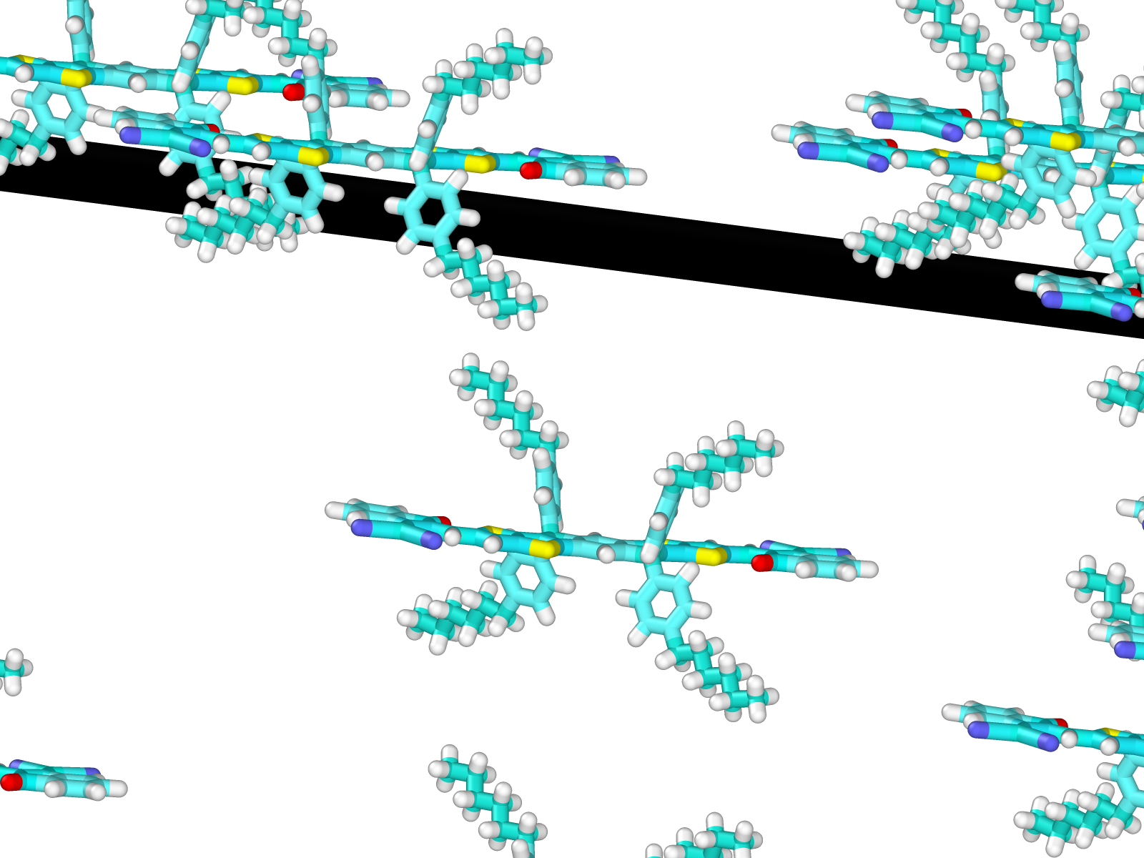
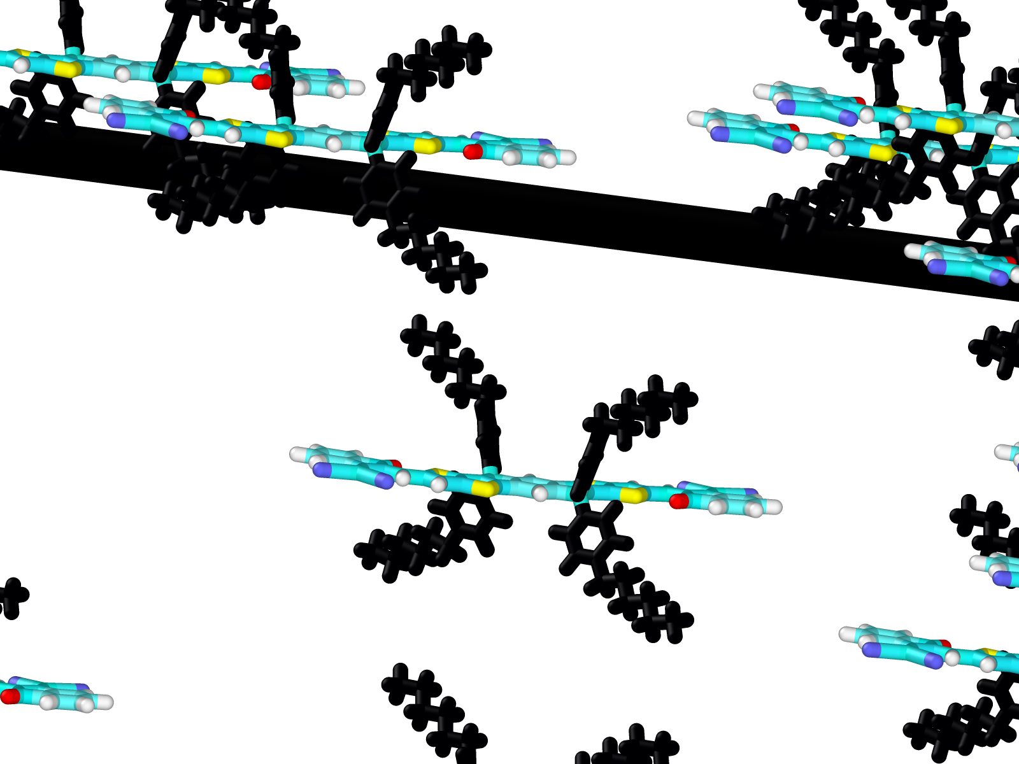
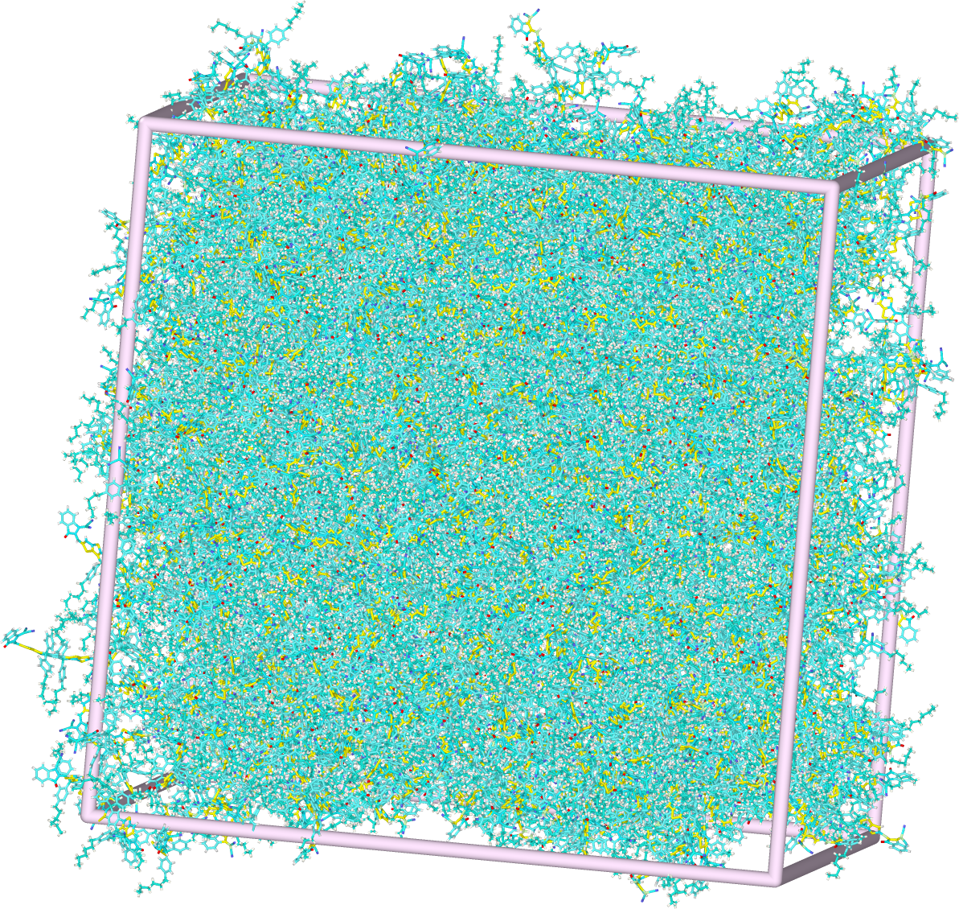
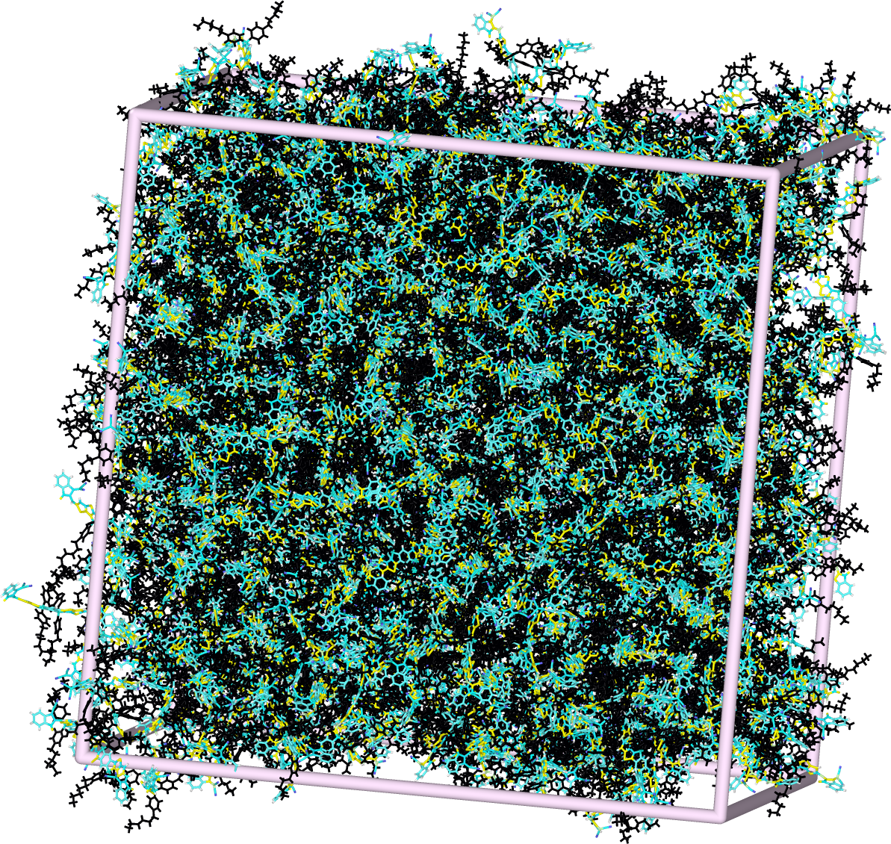
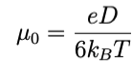
ITIC mobilities
?
?

Slide 21
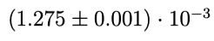

ITIC mobilities
ITIC mobilities from literature
Field effect experimental
10.1016/j.orgel.2018.04.028
10
-2
This work
10
-3
Other KMC study
10.1039/C7TC01310H
Low-field experimental
10.1016/j.orgel.2018.08.027
10
-4
Notes:
The reported experimental electron mobility of ITIC varies depending on how it was processed and how it was measured.
what are the differences in predictions from the difference chromophores
PUNCHLINE we developed the whole thing around P3HT bam It works for another

Slide 22
Conclusion
This pipeline and its current software stack replicates that of previous computational works as well as experimental works of P3HT.
The pipeline is extensible to other OPVs as we saw with ITIC.
From my firsthand account, I can say that this pipeline can deployed from scratch to investigate organic semiconductor conductivity and is a particularly well-oiled machine for many OPVs.
The packages for doing can be found at https://github.com/cmelab. In the interest of reproducibility and usability these include interactive workflows and tutorials that we have curated throughout our time developing these packages.

Slide 23
Acknowledgments
This material is based upon work supported by the National Science Foundation under Grant No. 1835593
This work was supported in part through the Department of Energy Advanced Sensors and Instrumentation program under DOE Idaho Operations Office Contract DE-AC07-05ID14517.

Slide 24

Bonus slides

Slide 25

Pipeline insensitive to the choice of lifetimes for fitting the slope of the MSD.
Jones, M. L., & Jankowski, E. (2017). Computationally connecting organic photovoltaic performance to atomistic arrangements and bulk morphology. Molecular Simulation, 43(10-11), 756–773. doi:10.1080/08927022.2017.1296958
Notes:
takeway: life times in this range are good enough.
Unlike what we saw with the reorganization energy
with the drastically different first lifetimes we don’t even get a 2X change in mobility value.
Another parameter that we experimented with was D-cut or neighbor cutoff distance.

Slide 26

Bonus slides
, , ,

Slide 27


Bonus slides
Notes:
A core tenet of Monte Carlo sampling is ensuring a large sample size. With a large enough sampling, significant reshuffling of the queue will take place, allowing for a rare hop to jump the queue. For example, a charge carrier that hopped a million times, and had exactly 5 neighbors at each hop, would require forming a million wait time queues and 5 million individual wait time calculations. Shuffling each wait time by ln (1/x), we can expect to see ∼50 wait times that have been shortened by 5 orders of magnitude, ∼500 shortened by 4 orders of magnitude, and so on.

Slide 28



Bonus slides Evans mobilities

Slide 29




Bonus slides
﻿Huang2005b
﻿Huang2005b

